Slide 1
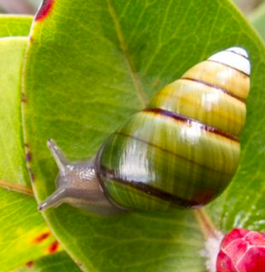
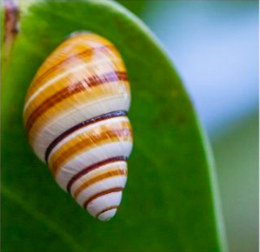
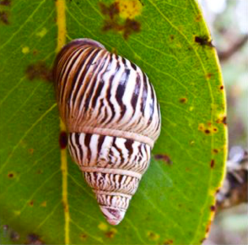
1
Native Snails
of Hawaiʻi
Native photos were graciously provided by David Sischo, Snail Extinction Prevention Program coordinator, Hawaii Dept. of Natural Resources- Division of Forestry and Wildlife.

Slide 2
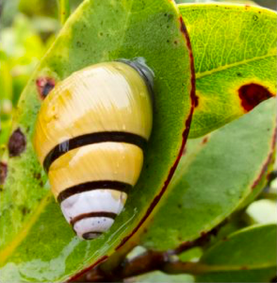
2
The land snails of Hawaiʻi live in native forests, including wet, mesic, and dry forests. However, more than 750 species of native snails once roamed Hawaii, and of these it is estimated that 50 - 90% of species have gone extinct. What happened? Why did some many of these species die out? Who, or what, was responsible for their extinction?
Photo: David Sischo

Slide 3
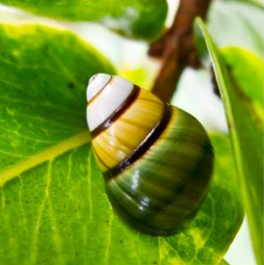
3
While non-native snails can self-fertilize and will lay many eggs in the course of a year or their lifetime, this is not the case with the native snails of the Hawaiian Islands. In fact, there is very limited information on the reproduction of our native snails. The most comprehensive information is on the Achatinella group, which only makes up about 5% of native land snail fauna. These native snails have a very slow reproduction rate. While they can live for up to ten years they may not reproduce until they are five to seven years old. Hawaiʻiʻs native snails evolved without predators and so they did not need to produce many, many offspring to survive.

Slide 4
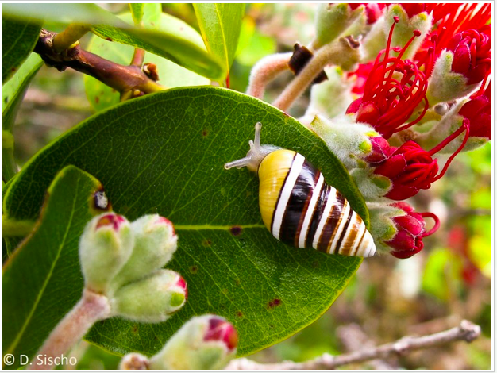
4
Over-collection by humans
The native snails of the Hawaiian Islands were so beautiful that in the 1800ʻs many people began to collect them. Some of these collections can be found in the museums of Hawaii, such as the Lyman Museum in Hilo, on Hawaiʻi Island, and the Bishop Museum, on Oahu. However, over-collection was one of the reasons that native snail numbers were reduced.

Slide 5
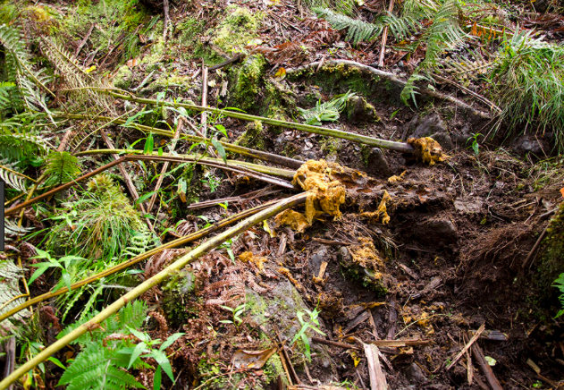
5
Habitat loss and degradation
Habitat destruction by ungulates, pigs and goats have been another factor in the reduction or extinction of populations of native snail species. However, the landscape is not only changed by these animals. Humans also play a major role in habitat loss.

Slide 6
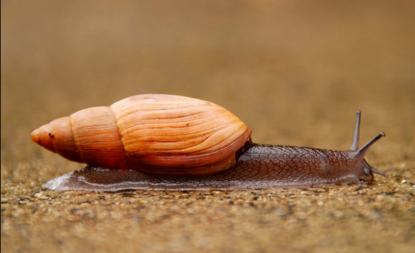
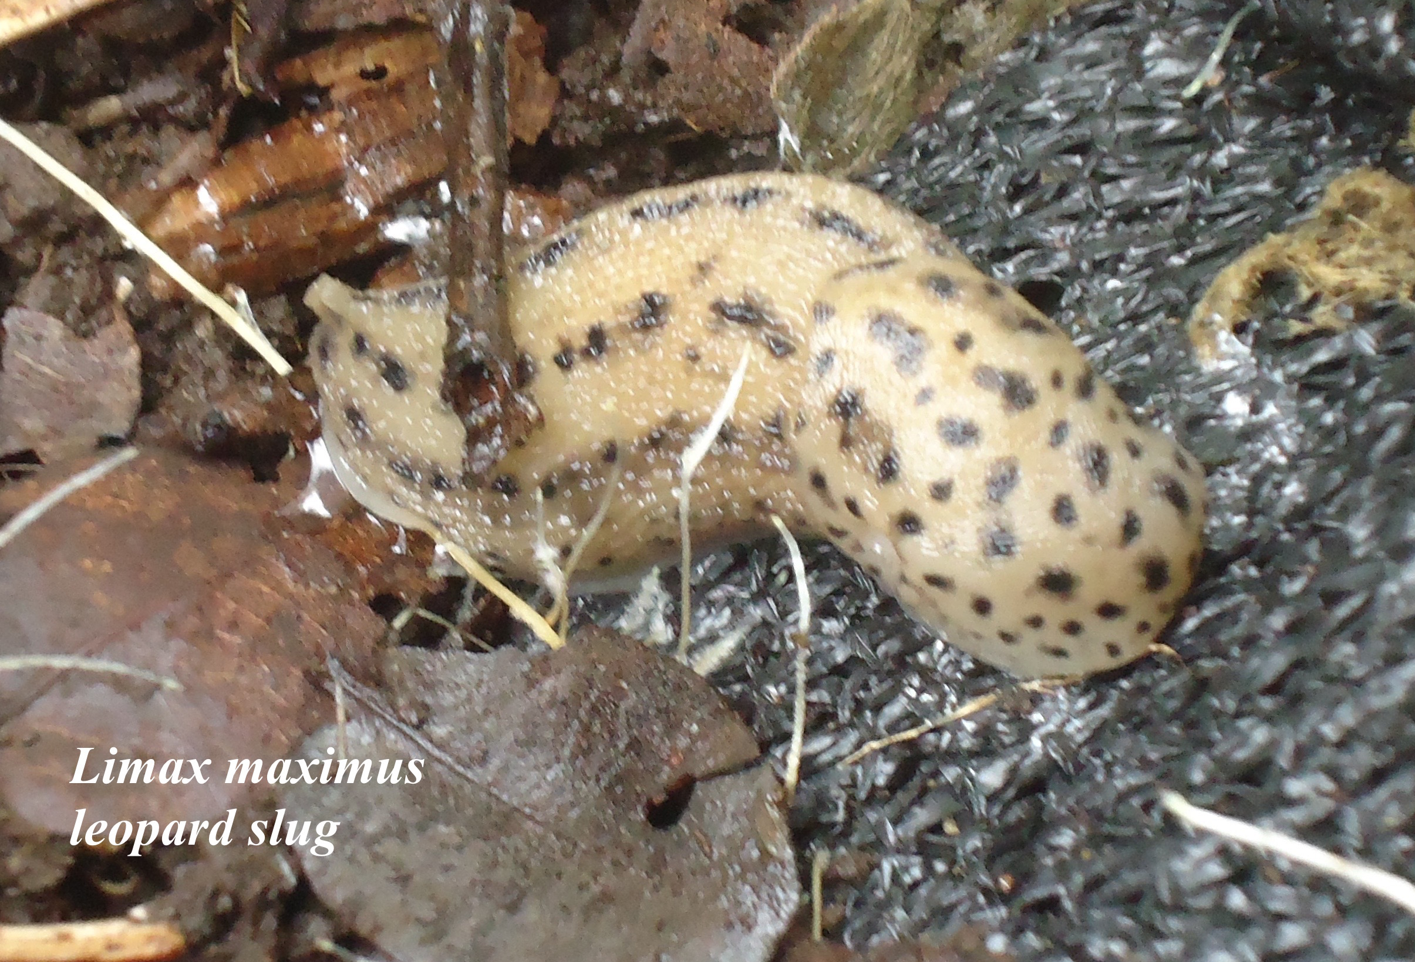
6
Predation is another factor in the loss and reduction of native species. The introduction of the giant African snail Achitina fulica in Hawaiʻi led to immense changes. In 1936 this snail was intentionally introduced to both Oahu and Maui. The snail was transported in baggage to Oahu and shipped to Maui via the mail. In no time their numbers increased and became a problem to farmers as they devoured crops. To try to reduce populations, predacious snail species were introduced to Hawaiʻi. However, instead of these predators going after the invasive giant African snails, these new arrivals began to prey on native snails. Today in Hawaiʻi there are predacious snails, slugs, and flatworms that are responsible for the loss and reduction of native snail species. Some of these predacious species of importance are Euglandia rosea, the rosy wolf snail, Limax maximus the leopard slug, and Platydemous manokwari the New Guinea flatworm.
Predation by non-native snails

Slide 7
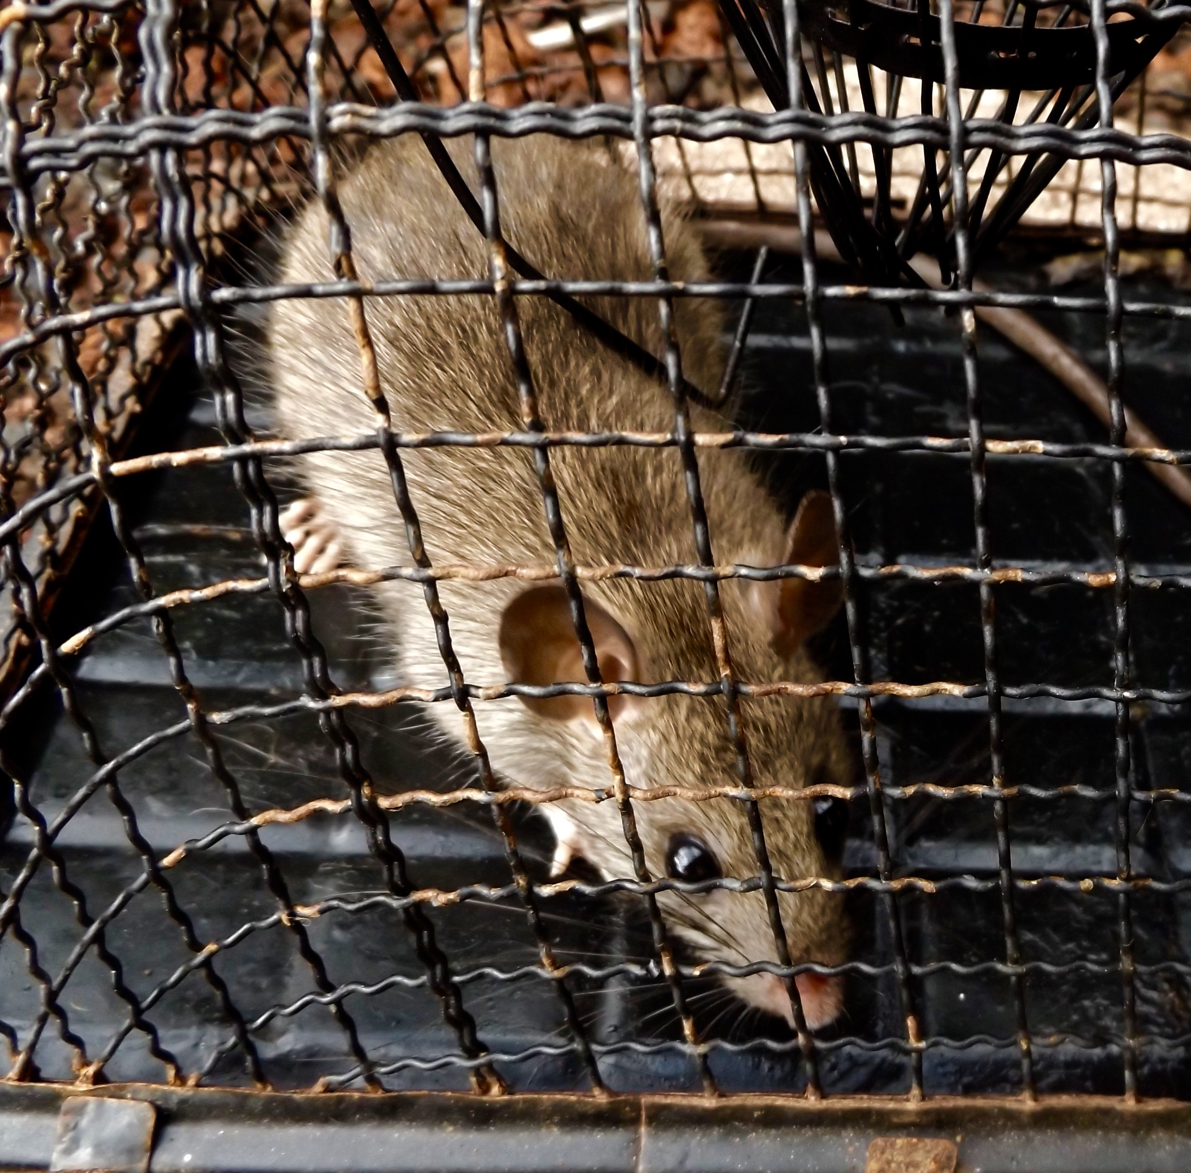
7
In addition to predation by non-native snails, slugs and flatworms, rats have been a major factor in extinction and reduction of native snails of Hawaiʻi. Rats, especially the tree rat or black rat, Rattus rattus were introduced to Hawaiʻi by ships that began to visit the islands during the age of colonization by Europeans. The Hawaiian tree snails in the Achatinella and Partulina genera are tree dwellers that fed on fungus growing on trees. These snails move slowly, often remaining in one tree for great lengths of time. The black rat are key predators of native snails and are responsible for the reduction in populations of not just snails, but many other endemic Hawaiian flora and fauna species. Besides rats, another predator of Hawaiian snails is the Jacksonʻs chameleon.
Predation by rats

Slide 8
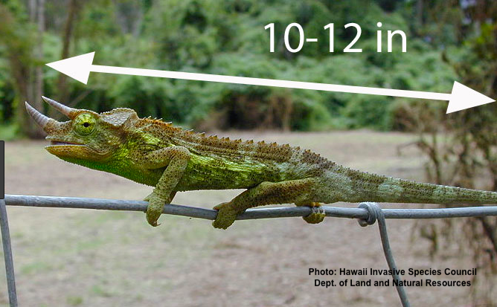
8
Predation by reptiles: Jackson’s chameleon
Scientists are studying the impact of an introduced reptile on Hawaiʻi’s native species. These chameleons prey on flying insects, spiders, centipedes, isopoods, millipedes, snails, lizards, and small birds. Native insects and native snails, including endangered snails, have been found in the dissected stomachs of Jackson’s chameleons Chamaeleo jacksonii. The Jackson’s chameleon was introduced to Oahu Hawaiʻi in the 1970ʻs as part of the pet trade. People found them quite appealing, transported them as pets, and they are now established on all of the main Hawaiian Islands. The chameleon lives in wetter habitats from 100 – 1000 meters in elevation. Their ecological impact on native species is only beginning to be studied and understood. Scientists know that the chameleon is undergoing a range expansion and may move into upper elevation, native forests, and impact native species, including threatened and endangered, including native snails.

Slide 9
Climate change
Climate change will contribute to the challenges already faced by Hawaiʻi’s native snail populations. Rising temperatures and greater rainfall will cause more habitat to be lost. Invasive species will continue to impact our native species and their ranges will expand. The loss of native ʻohiʻa forests from rapid ʻohiʻa death, predatory slugs and snails, chameleons, little fire ants, rats, pigs and even coqui frogs create challenges for native species including native snails. Humans contribute to these problems as we change the landscape with our actions. What is to be done?

Slide 10
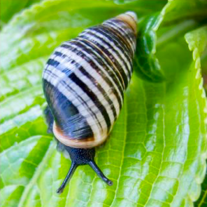
Conservation
Because of the loss of so many of the rare species of snails found in Hawaiʻi, efforts are being made to preserve and grow populations. The Hawaiʻi Department of Land and Natural Resources (DLNR), Division of Forestry and Wildlife, and the University of Hawaii at Manoa have native snail extinction prevention and breeding programs, created to protect and increase numbers of native snails. You can learn more about these efforts and the preservation of native species and ecosystems of Hawaiʻi by viewing these YouTube videos:
Video 1
Video 2
Video 3
Photo: David Sischo

Slide 11
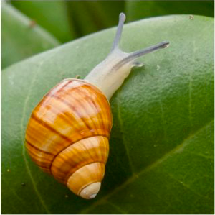
Learn more about the native land snails of Hawaiʻi
Dr. Norine Yeung at the Bishop Museum:
Dr. Norine Yeung at the Bishop Museum
Snail Extinction Prevention Program:
Snail Extinction Prevention Program
The Hawaiian Tree Snail Conservation Program:
http://www2.hawaii.edu/~trsnlab/
Photo: David Sischo

