Slide 1
Data matters
Data matters

Slide 2
Become a citizen scientist!
Become a Citizen Scientist!
A citizen scientist participates in the collection and analysis of data relating to the natural world by members of the general public, typically as part of a collaborative project with professional scientists. For this project you are working with scientists from the University of Hawaii, and you are collecting information that is important to the Hawaii Department of Health and the Hawaii Department of Agriculture. Your observations will help you become an expert at identification, which will allow you to recognize when a new slug or snail pest arrives in your area. Early detection is very important to prevent the establishment of new species in your area, such as the semi-slug, which we know is a very effective host of the rat lungworm.

Slide 3
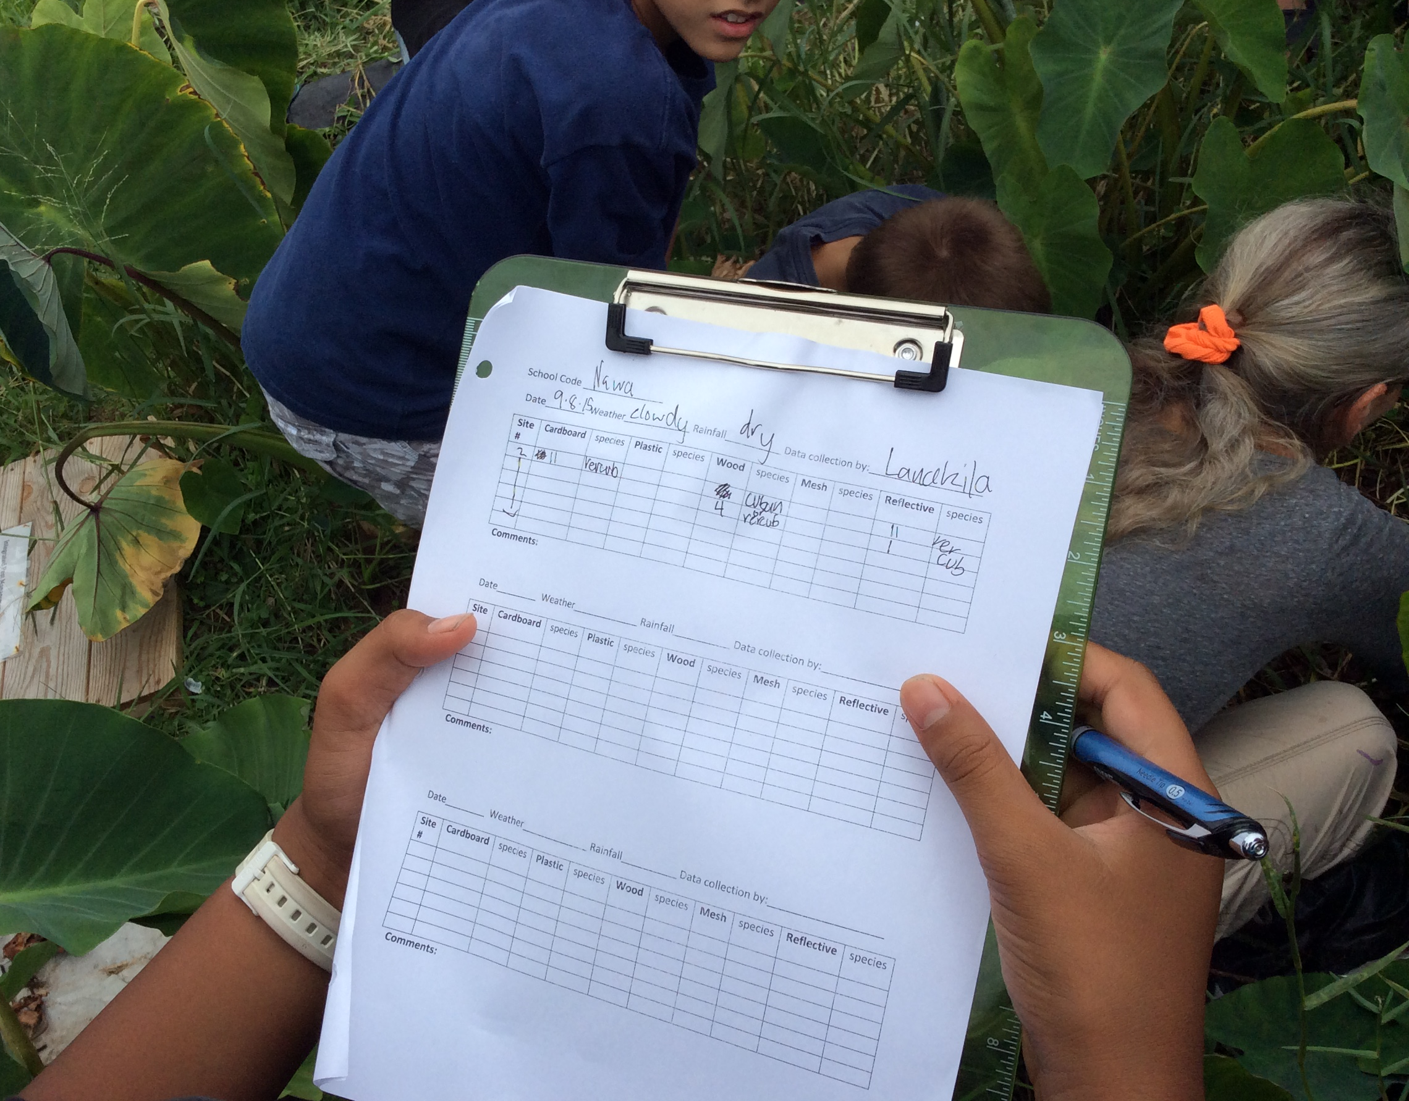
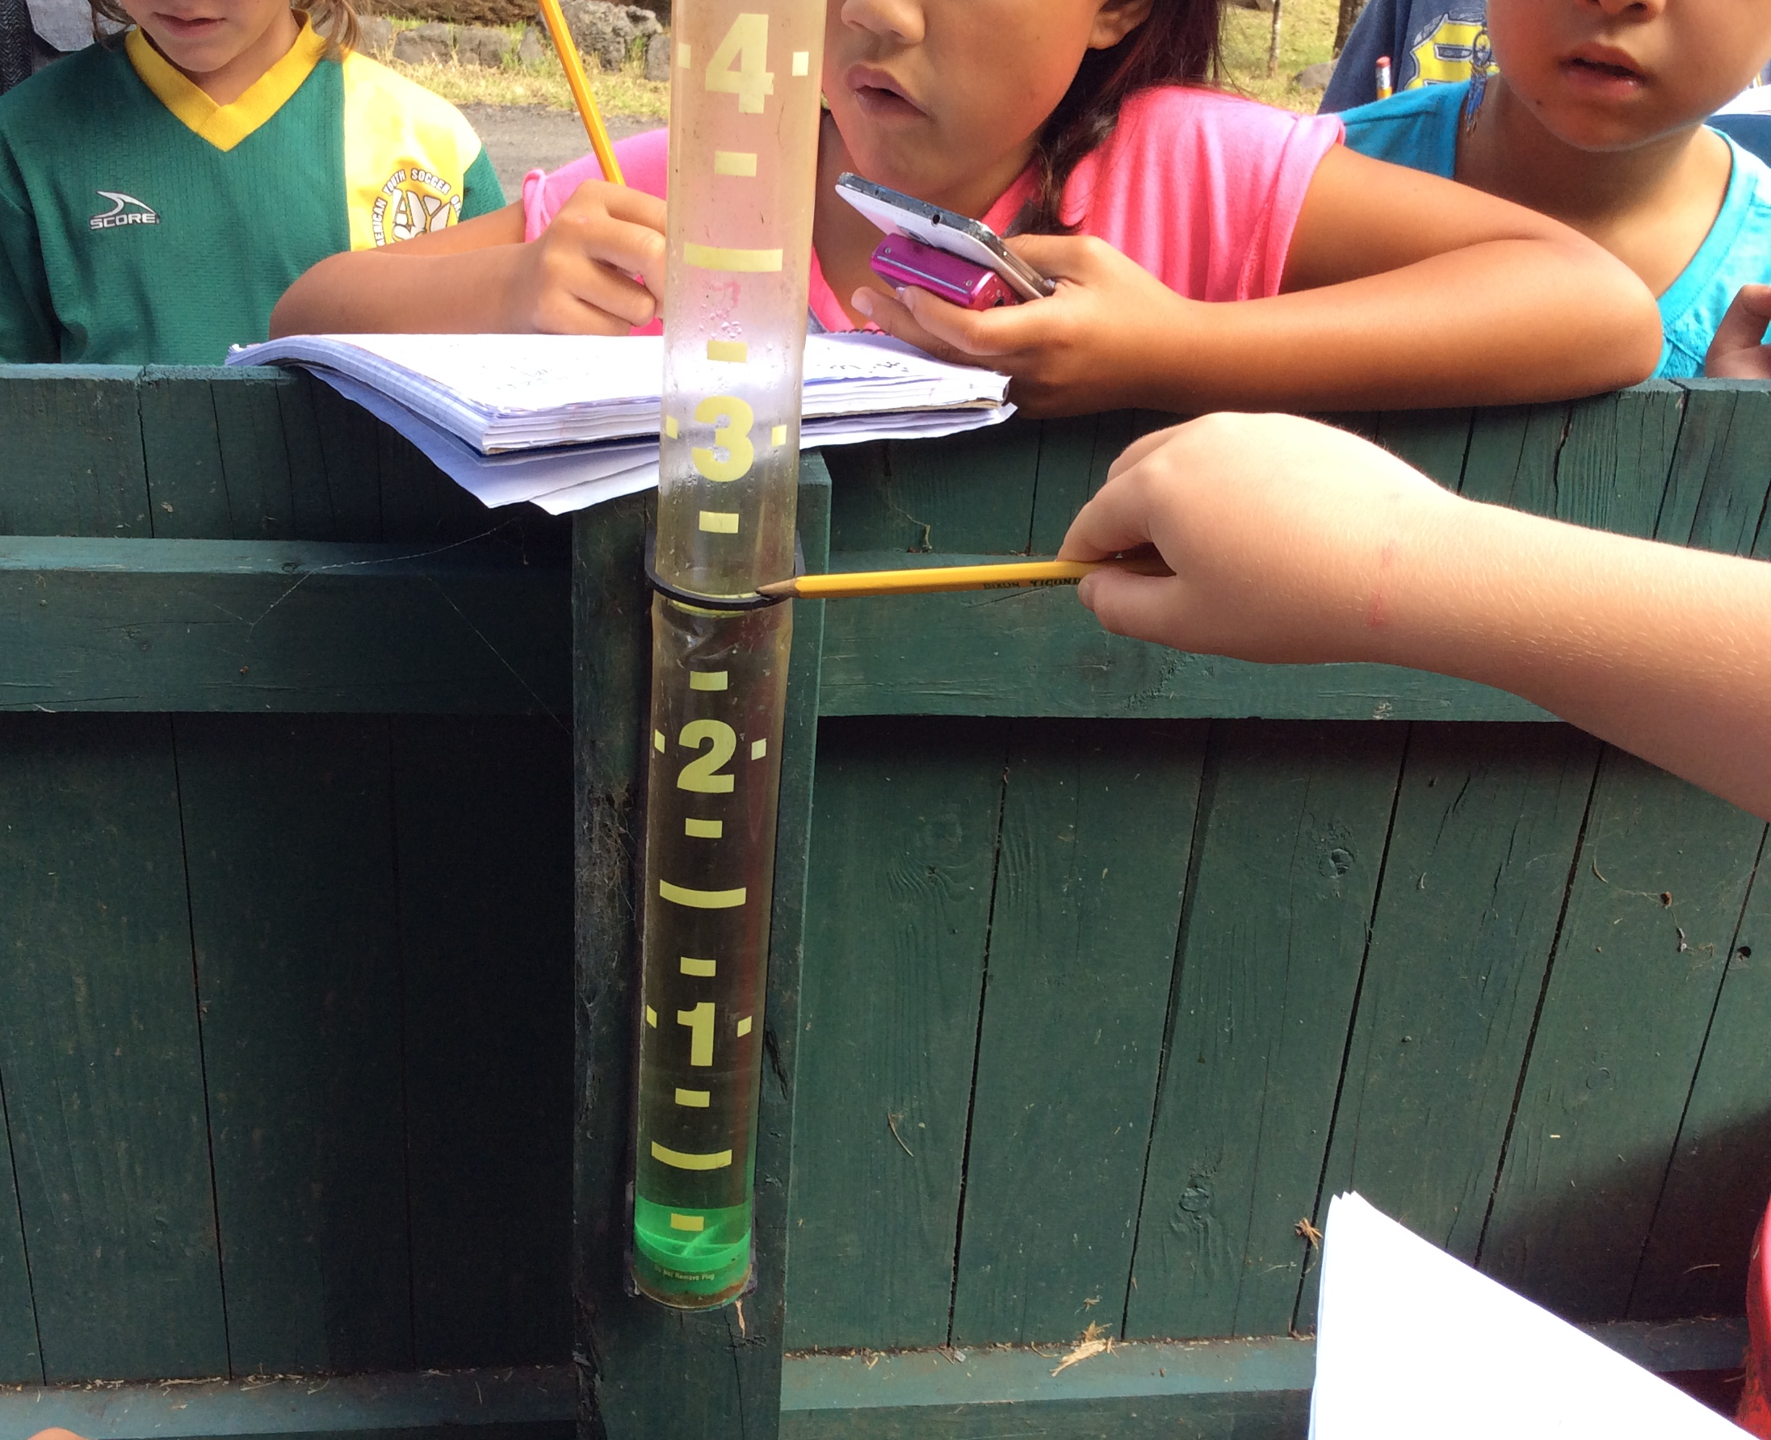
What is data and why do we collect it?
What is data and why do we collect it?
We can use the data we collect to observe patterns and make predictions.
On the next slide you will see an example of a data sheet
that will be used to record your observations.

Slide 4
Slide 4
School name_______________________________________ Island _________________________
GPS coordinates _________________________________Elevation _________________________
Date ______________________Weather ____________________Rainfall amount ____________
Moon phase _____________________________________________________________________
Data collected by _________________________________________________________________
Site | Card board | Species | Plastic | Species | Wood | Species | Mesh | Species | Tarp | Species | Other | Species
1 | III | VER CUB | IIII II | PAR MAR |  |  |  |  | IIII | PAR MAR
 |  |  |  |  |  |  |  |  | III | ACH FUL
 |  |  |  |  |  |  |  |  | IIII | PAR MAR
Comments:

Slide 5
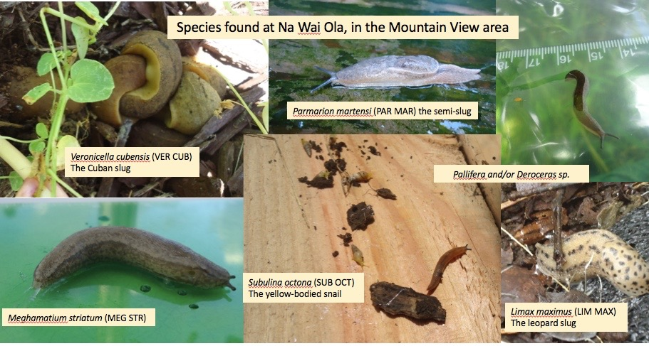
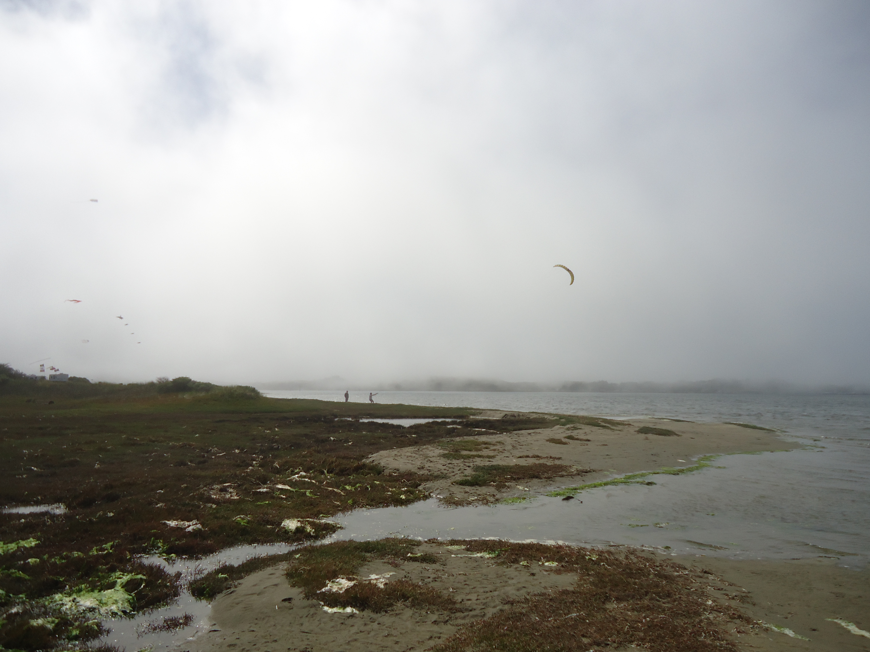
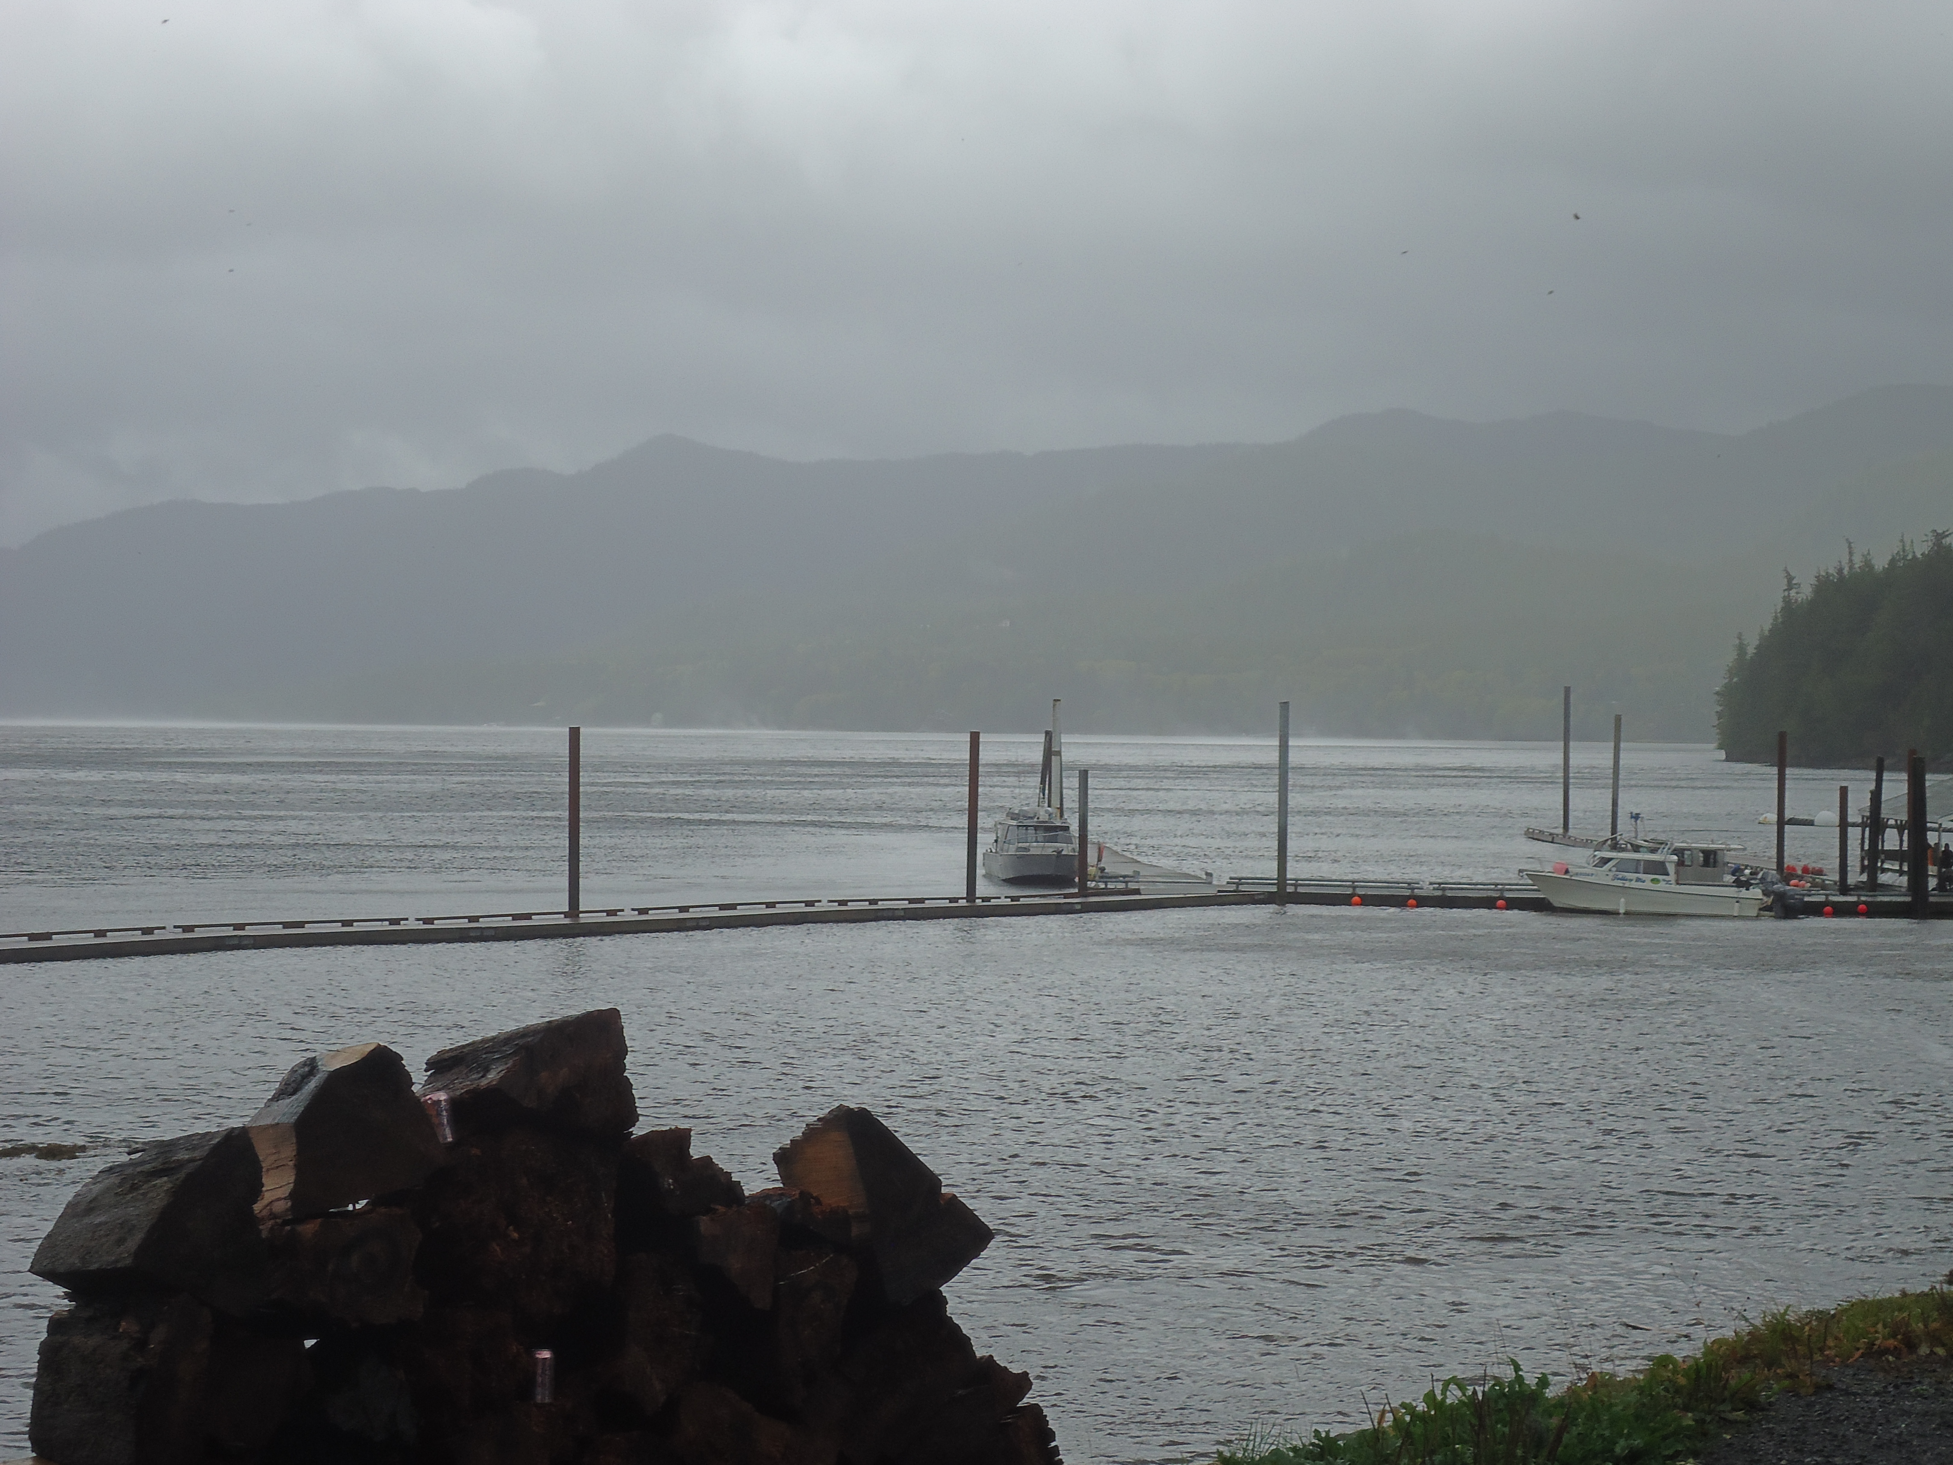
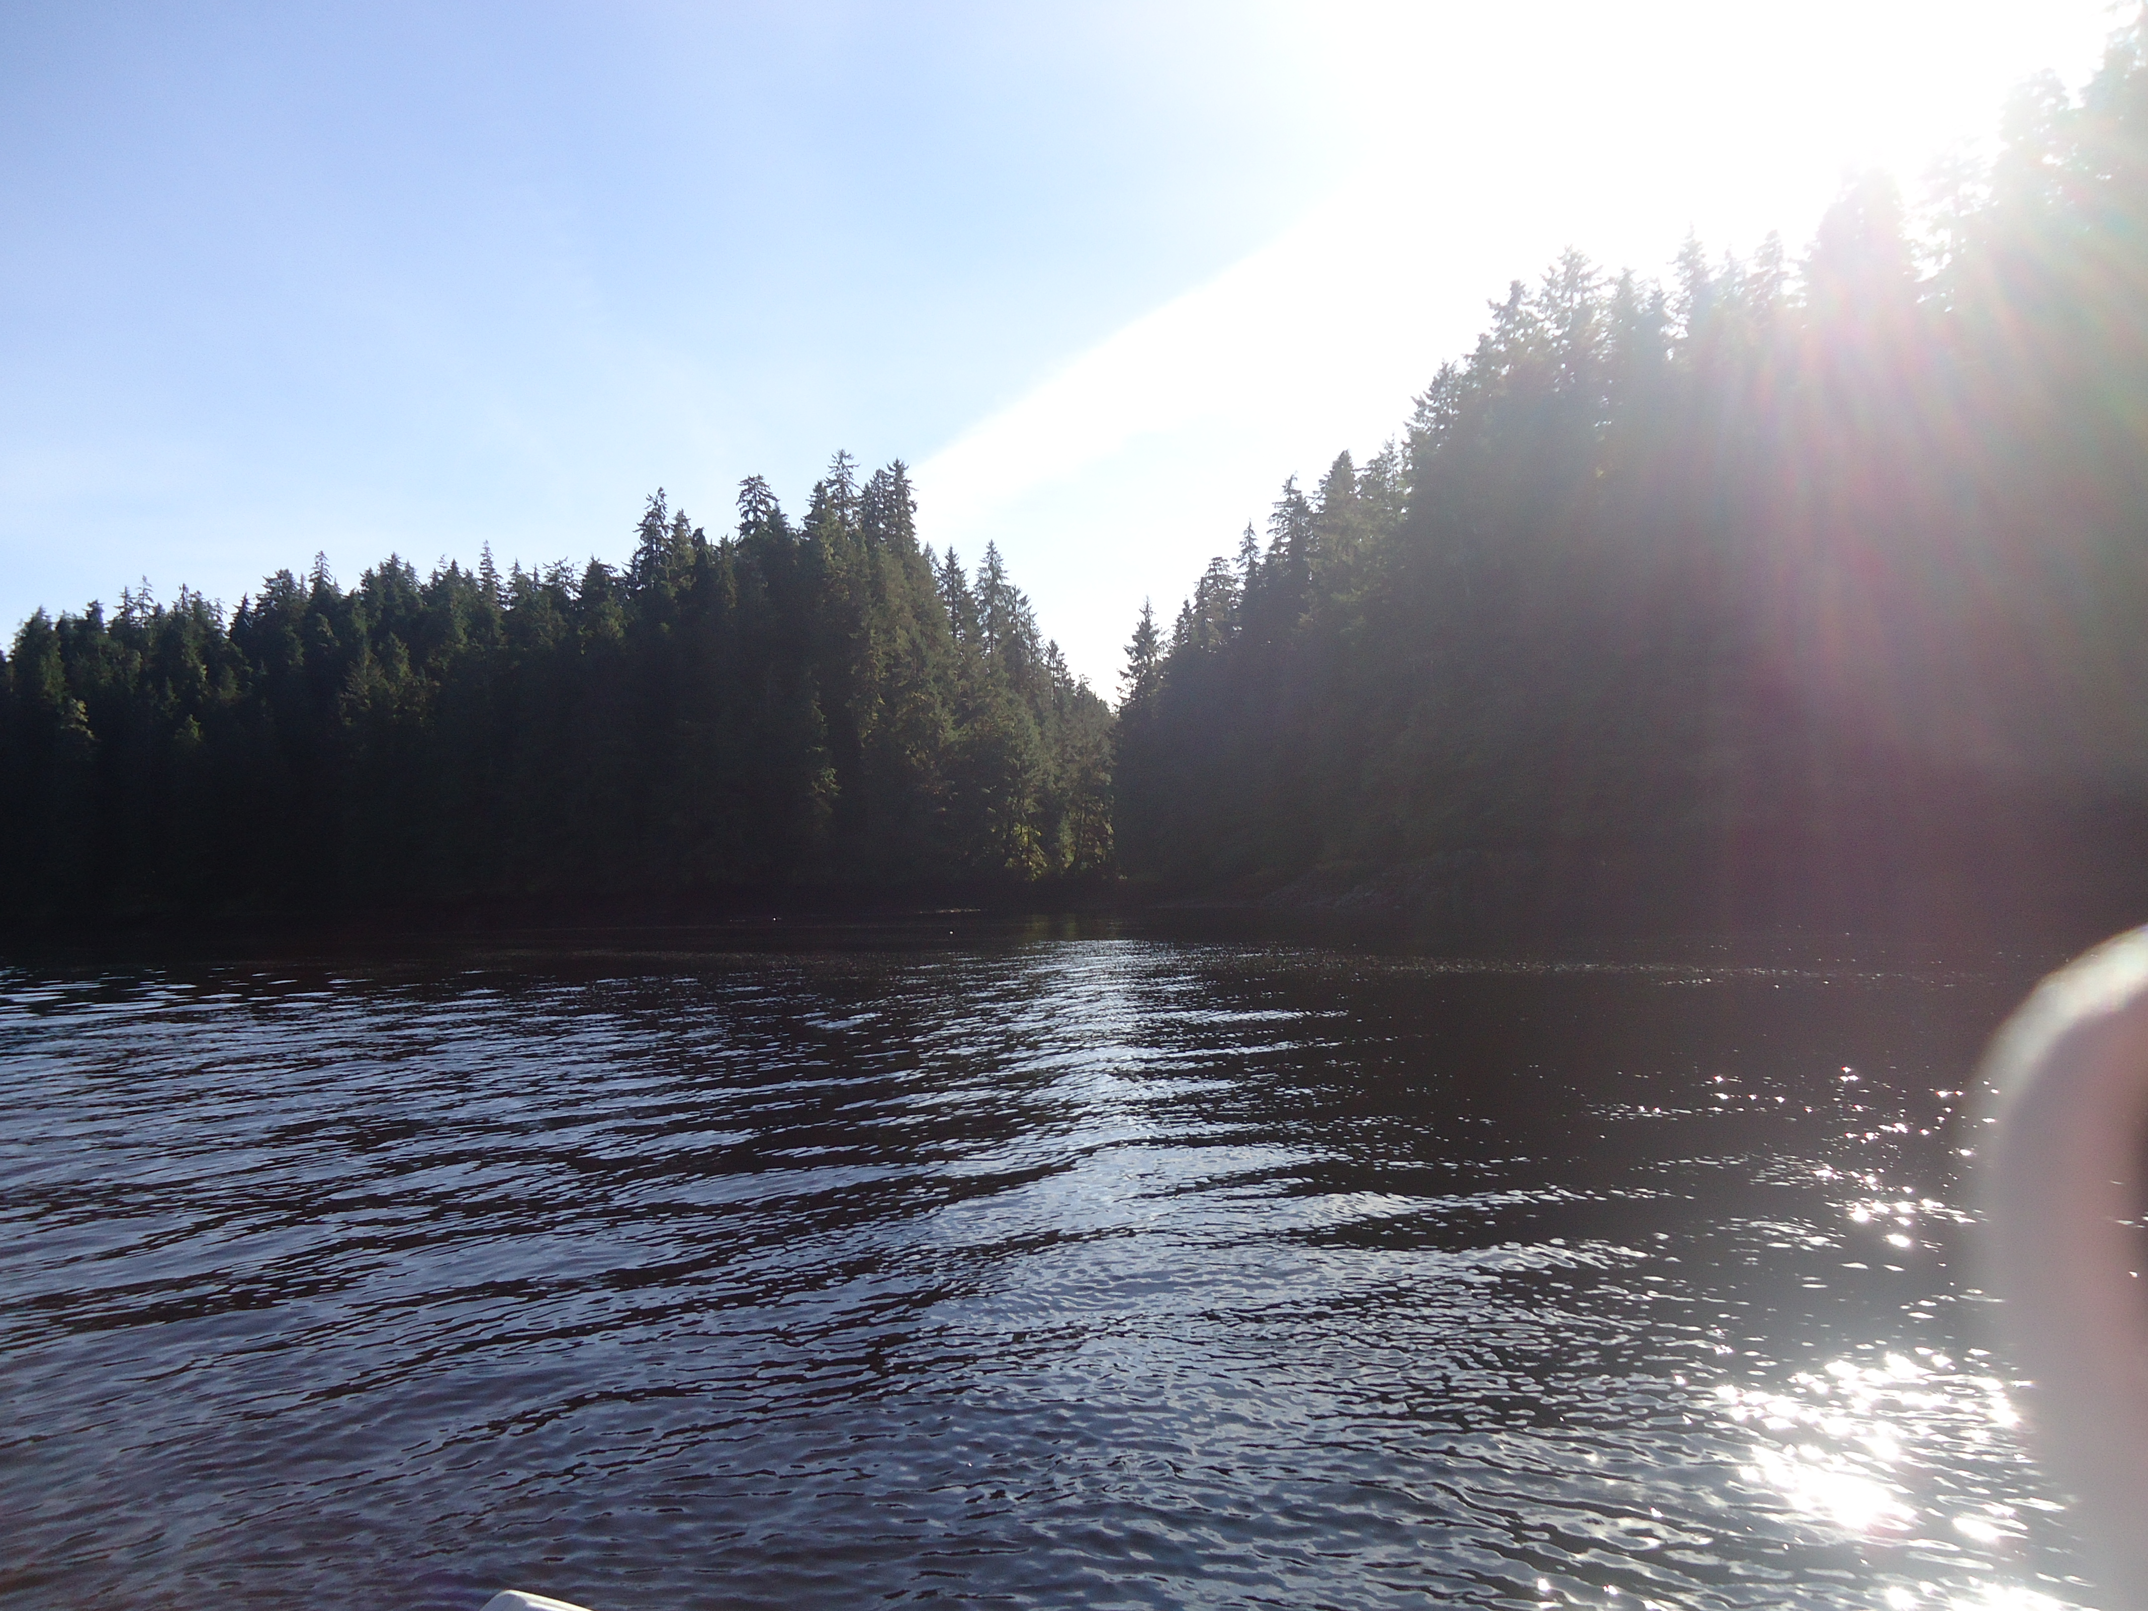
Types of data: categorical
Types of data: categorical/qualitative
Some of the data collected will be words that describe a category or quality of some variable you are interested in. This type of data is called categorical or qualitative data. Examples of qualitative data would be the weather conditions, such as sunny, cloudy, etc. What other types of data that you will be collecting will be qualitative?
Notes:
Other categorical/qualitative data includes species type, trap type, moon phase, island, school name, data collected by.

Slide 6
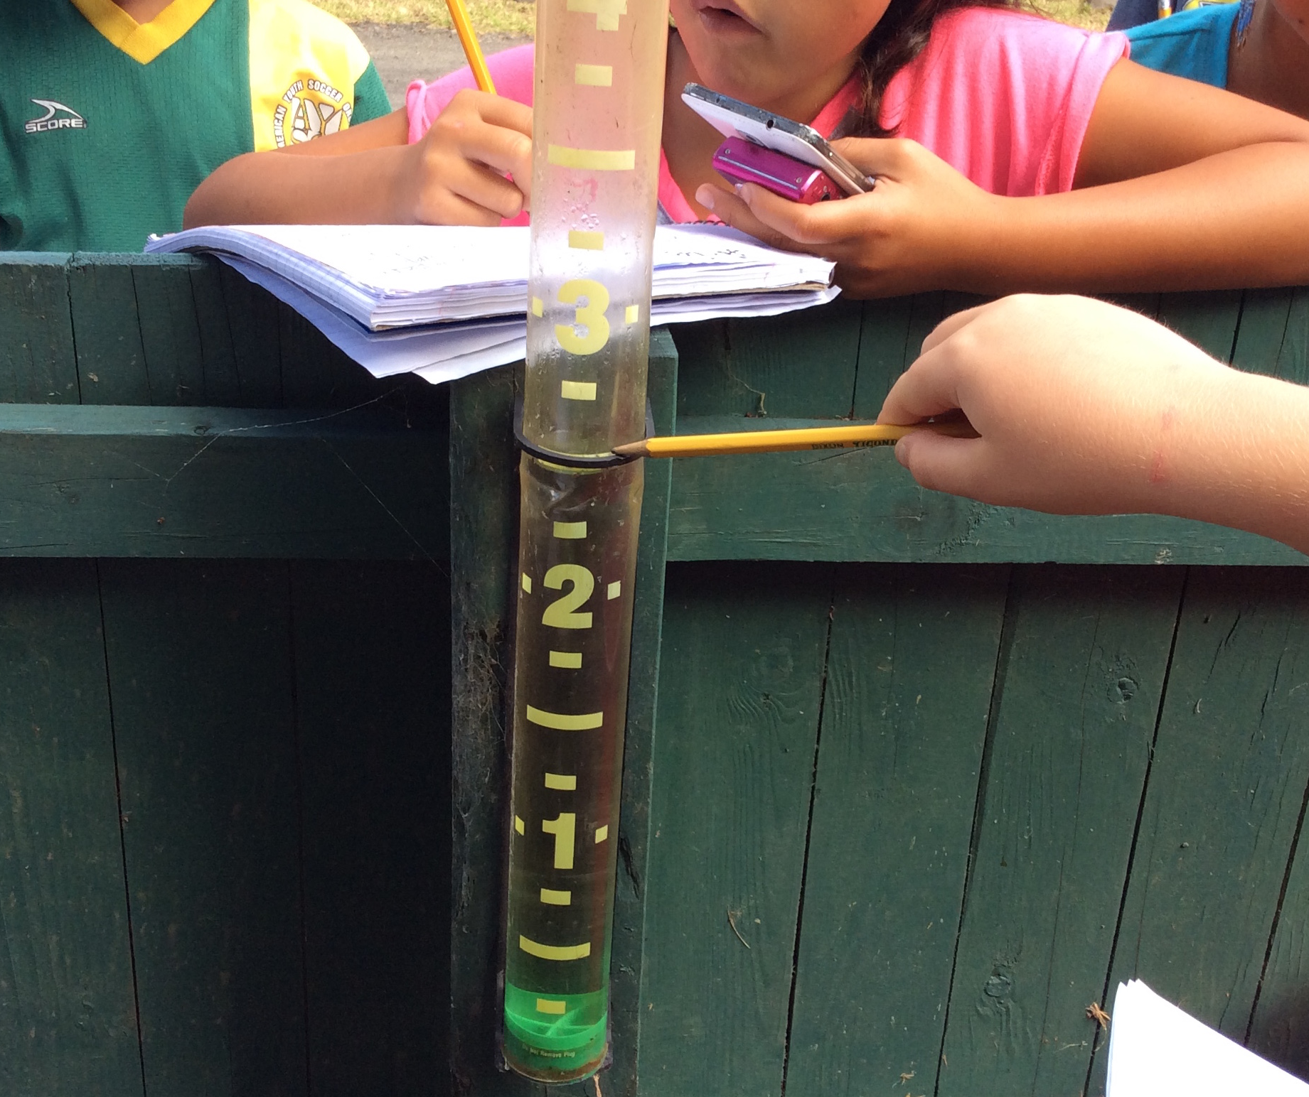
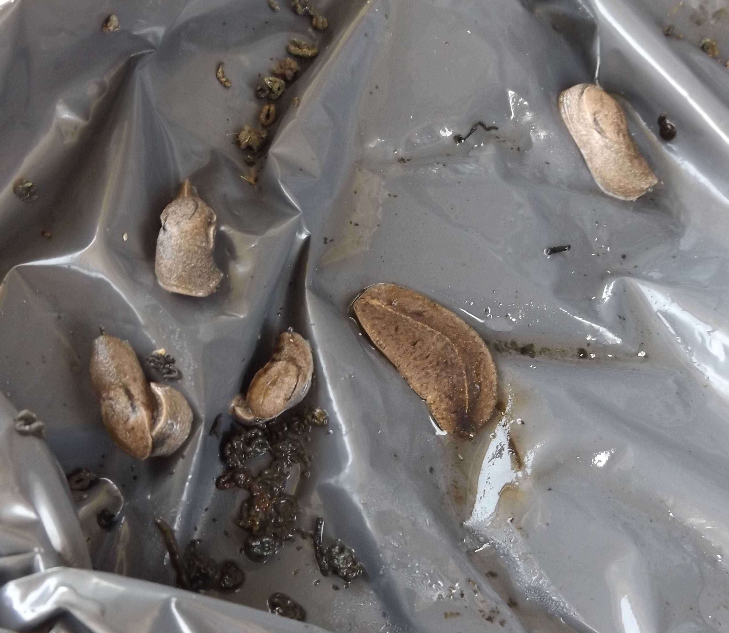
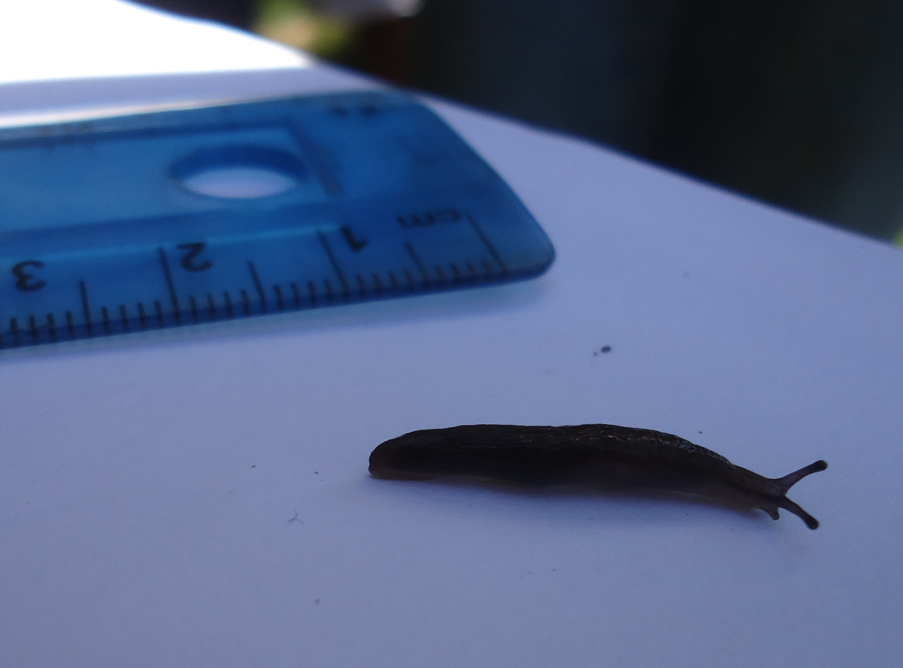
Types of data
Types of Data: quantitative variable
Another type of data collected is quantitative data, and the data we collect will be numeric, and describes quantity. Quantitative variables are real numbers that can be added. The data you will collect will generally be whole numbers (0, 1, 2, 3….) rational numbers (2.3, 1.7, 5.2 etc.).
What is being measured or counted in the pictures below?

Slide 7
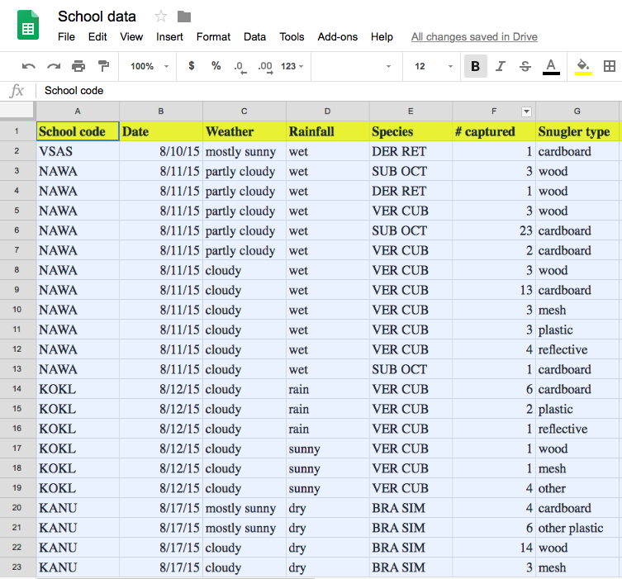
Math
Letʻs do the math!
The data that is collected in the school garden should be entered into a Google spreadsheet back in the classroom. Now you are ready to do some analysis and put math to work for you!

Slide 8
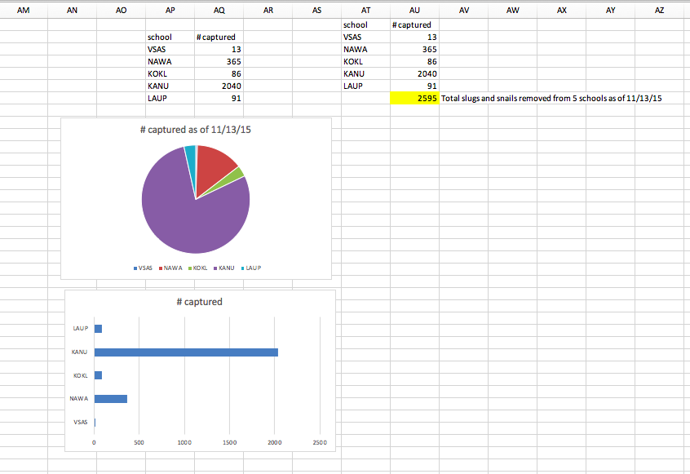
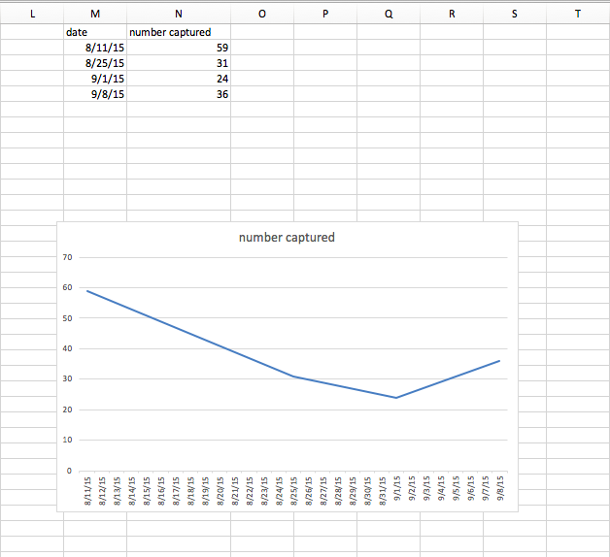
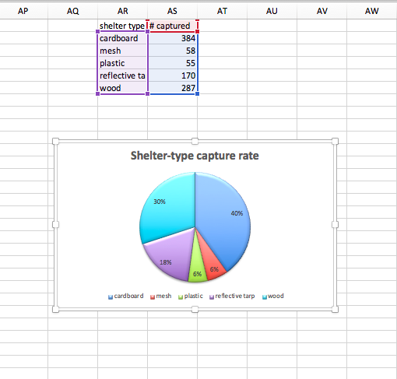
Slide 8
Our numbers can be turned into pictures to show information such as how many of each species were collected, what was the shelter-type capture rate, and how did the numbers of slugs and snails collected vary over time.

Slide 9
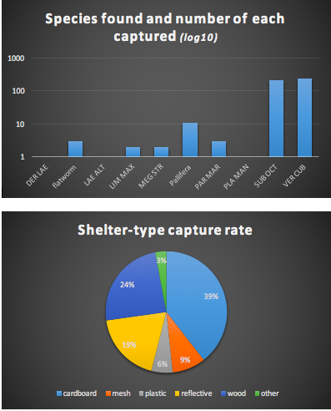
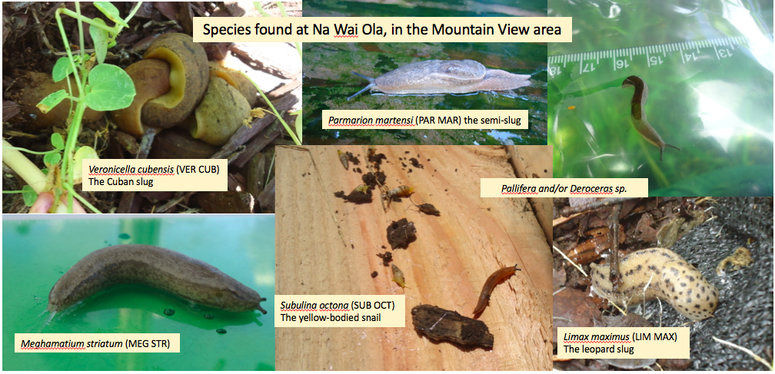
Slide 9
Pie charts, bar graphs, scatter plots, and trend lines can show graphically (in pictures) what your results are and make all of those numbers easier for your audience to understand more quickly.

Slide 10
Slide 10
Collecting data gives us the true picture of the results of our efforts. From this we can know if we are making headway in the efforts to reduce the intermediate hosts of the rat lungworm. We can also use the data to see if slug and snail populations vary according to the time of the year, or the amount of rainfall recorded. Data is very important in helping us to better understand slug and snail populations. The data you collect will be entered into a large data base that can be used by researchers to better understand the situation with non-native slugs and snails in Hawaii. Your data matters!

