Slide 1
Precautions for angiostrongyliasis (rat lungworm disease) prevention

Slide 2
1
Semi-slug in a commercially prepared salad.
Inspect and wash all produce. Headed vegetables, such as lettuces, celery, and bok choy need to be taken apart and inspected and each leaf or stalk must be washed individually. If a slug or snail, or signs of slug/snail activity (chew marks, feces) is found discard the entire vegetable. There is currently no FDA approved vegetable rinse that is known to be effective against the rat lungworm.

Slide 3
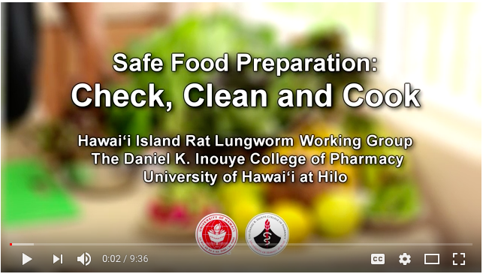
3
Watch this food preparation video. Safe Food Preparation: Check, Clean and Cook

Slide 4
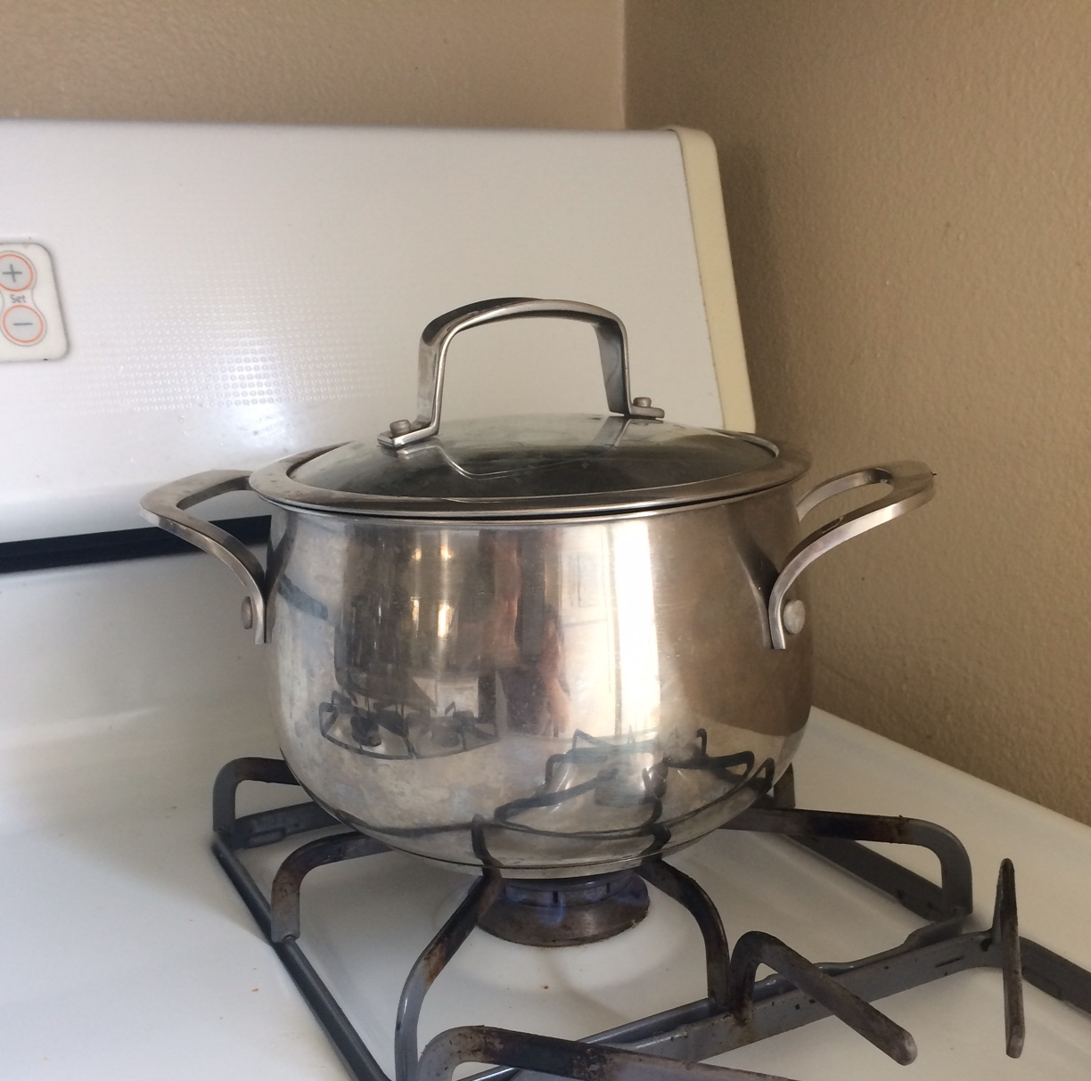
4
Cook or Freeze
Cooking vegetables by boiling or steaming for 3-5 minutes. Freezing for at least 24 hours at -15º C has been shown to kill the larvae is a good precaution to prevent infection. Some cultures do eat snails and they must be well cooked. Remember, paratenic hosts, such as shrimp, prawns, crabs, frogs, etc., can be infected and must be cooked before consumption. Drying will also kill the larvae.
Freeze for 24 hours at -15º C (5º F).
Boil for 3 minutes (100º C / 212º F at sea level).
Notes:
Slide 5: Cooking and freezing are very effective measures to prevent rat lungworm disease. Early studies in Hawaii by Alicata showed freezing vegetables for 24 hours -15º C (5º F) will kill the parasite and is a good precaution to prevent infection. Alicata also did a study on cooking, and found that boiling for steaming vegetables for 3-5 minutes will kill the larvae. Remember that water boils at 100º C (212º F) at sea level, but as the elevation increases water will boil at a lower temperature and so cooking times must be longer at higher locations.

Slide 5
Studies have shown that slugs and snails can shed infective stage rat lungworm larvae when drowned in water. In wet conditions these larvae can live outside of the intermediate host for many days. Take the following precautions.

Slide 6
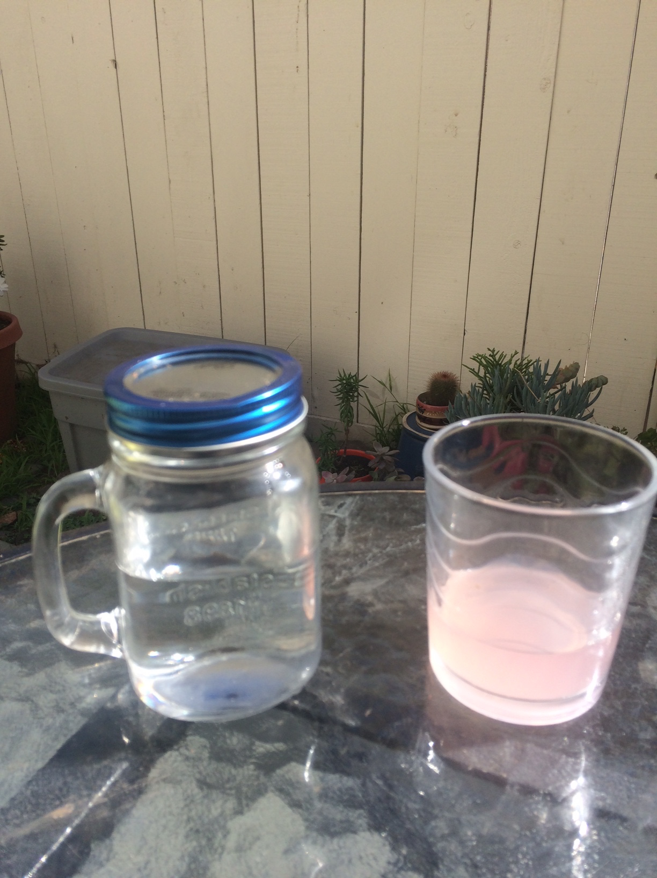
6
Cover food and beverages in outside settings.
Food and drinks enjoyed at potlucks, picnics, camping, and outdoor settings in general should be covered. Slugs and snails can crawl unnoticed into or onto foods and can contaminate them. There have been incidences of cases of angiostrongyliasis that have been caused by a slug crawling into a beverage.
Yes!
No!

Slide 7
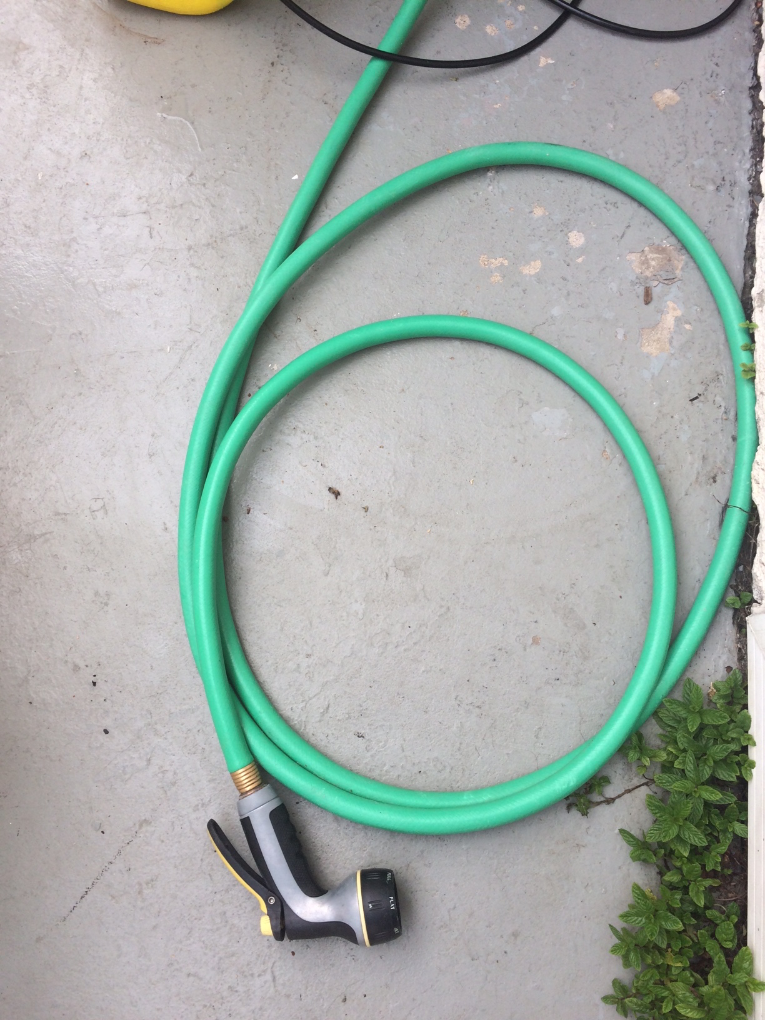
7
Put nozzles on hoses to prevent entry by slugs, snails, or flatworms.
Do not drink from garden hoses. There have been reports of rat lungworm infections resulting from drinking from a garden hose. Be mindful of filling water pet/livestock bowls/buckets with garden hoses, always keep a nozzle or end cap to prevent entry by slugs or snails. Many animals are susceptible to rat lungworm disease and symptoms can be similar to those in humans.

Slide 8
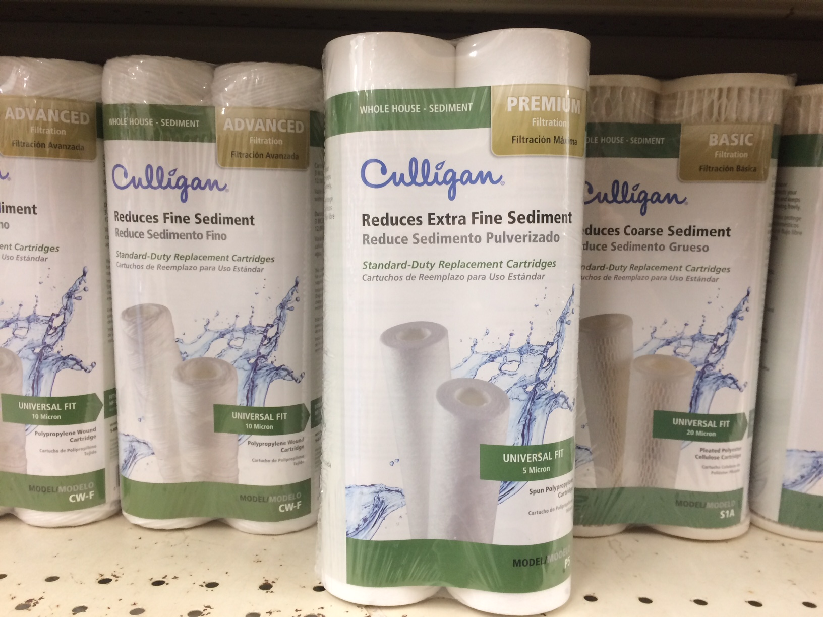
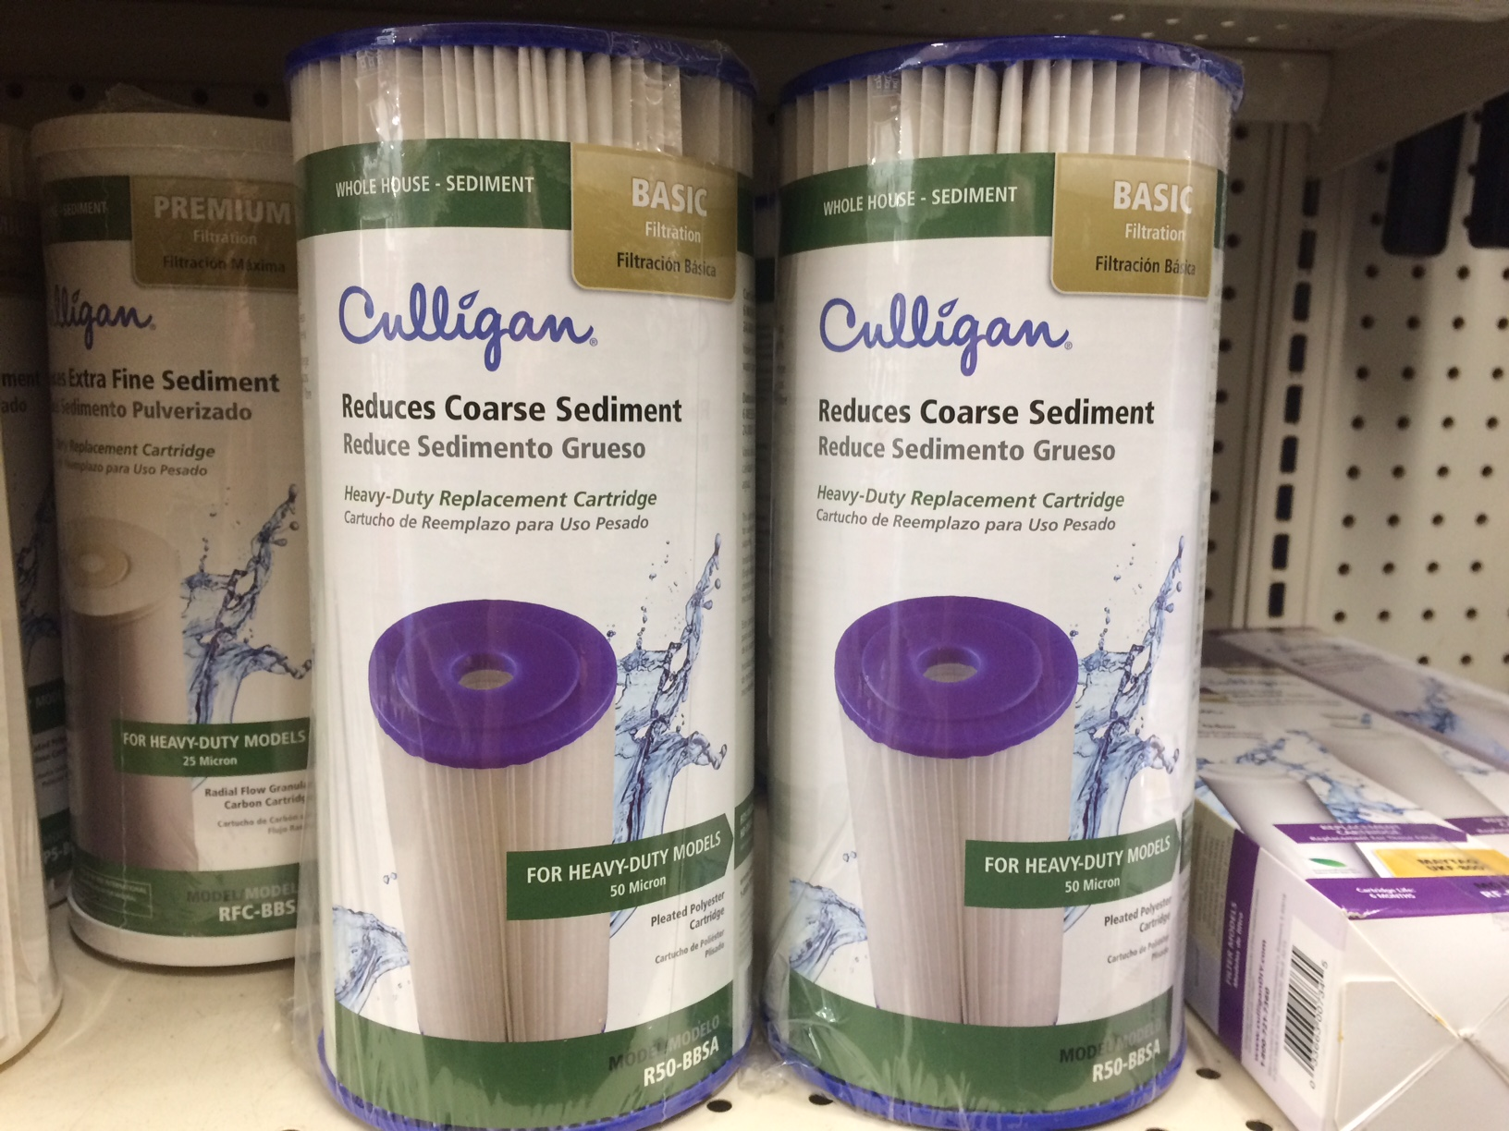
8
Rainwater Catchment
Many people in Hawaii rely on rainwater catchment for their water supply. Proper design and maintenance of rainwater catchment tanks for potable household use are very important.
Use a first flow diverter.
Keep roofs clear and gutters clean, screen intake to tank to keep out large debris.
Make sure the tank is properly covered.
Have your tank cleaned regularly (1-3 years).
Use 20µm plus a 5µm carbon block filter
Change filters regularly.
Use whole house UV and clean and change bulbs regularly.
Boil drinking water 3 minutes if necessary.
Rainwater Catchment systems guidebook for Hawai’i.

Slide 9
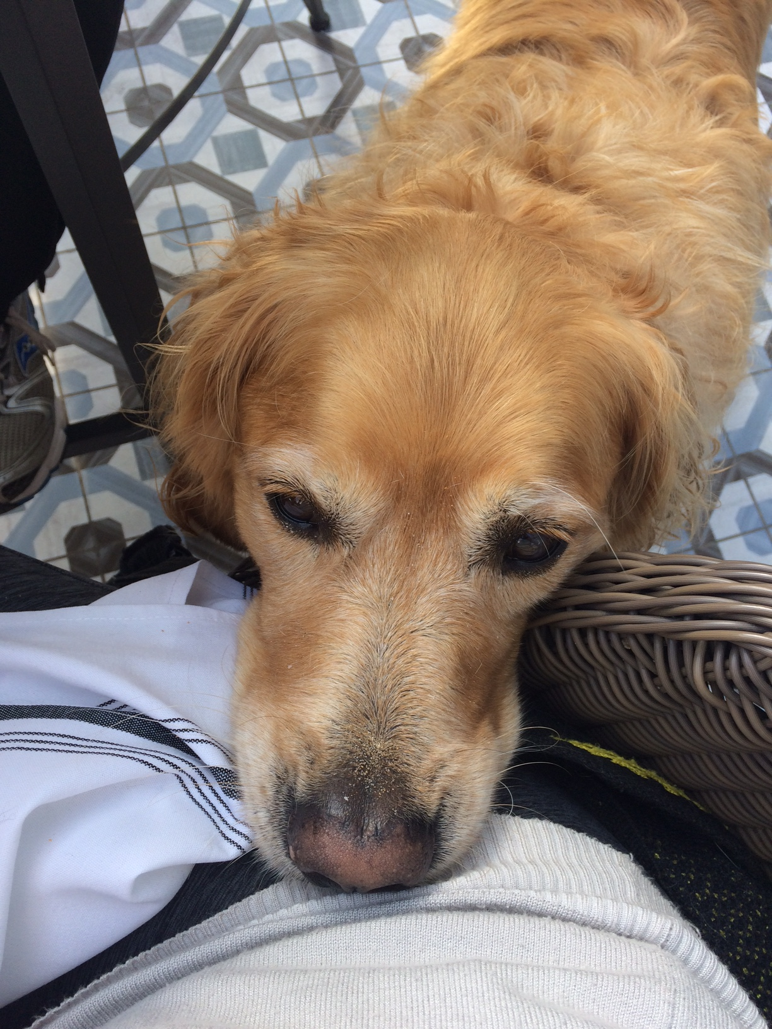
9
Bring in Pet Food Dishes
Many slugs and snail species are attracted to pet food.
Dogs, especially puppies, are susceptible to contracting rat lungworm disease.
Bring pet dishes in at night, check to make sure there are no slugs or snails in the bowls before you bring them in. Baby or juvenile slugs and snails can be small, so inspect the dish carefully to ensure you do not bring pests inside.
If watering pets or livestock make sure to put a nozzle on the end of the hose, and allow water to flush the hose before filling water dishes or buckets.
Control for hosts of the rat lungworm parasite (rats, slugs & snails).
Notes:
Slide 10: Slugs and snails are attracted to pet food and people report finding these pests in and around pet food bowls. Carefully check to make sure no unwanted pests are in the bowl and bring pet food dishes, including water bowls, indoors in the evening. Veterinarians report cases of angiostrongyliasis in dogs, particularly in puppies, who are not selective eaters and tend to eat quickly. Cases in horses have also been reported, and zoo animals are often affected as there are often scraps and morsels of food inside and around enclosures. When watering animals from a hose, be sure to let the water run, which can help flush debris from the hose. Also, keep a nozzle on hoses to prevent entry by unwatned pests. And control for rats and slugs and snails is always an important, preventative measure.

Slide 10
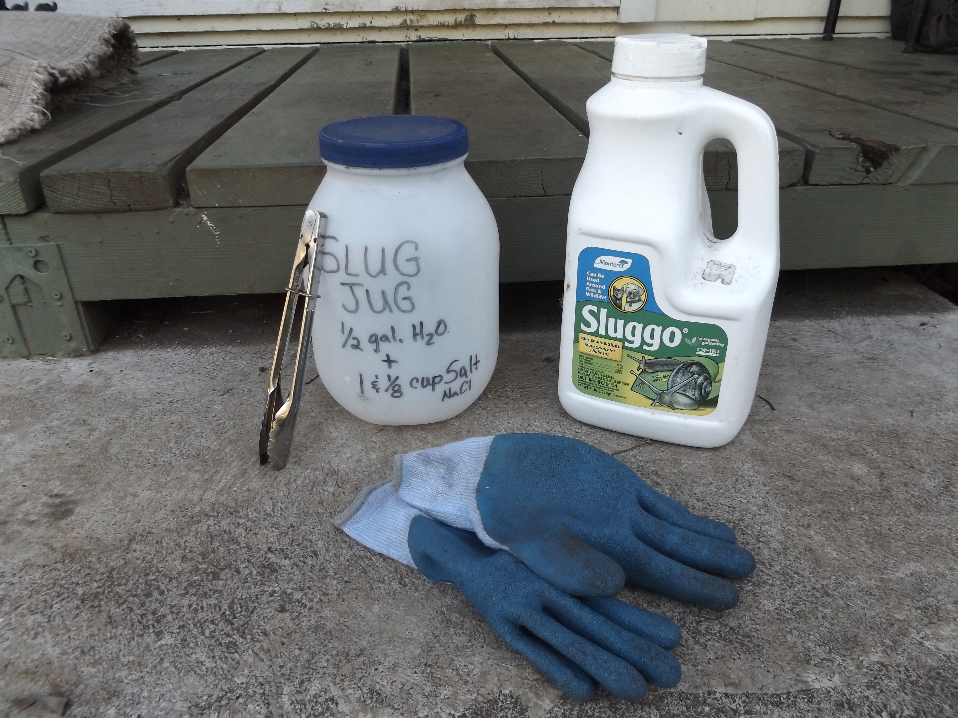
10
Control and Removal
Use of hand-picking, shelters, and slug baits can help reduce populations of intermediate hosts.
Use tongs or chopsticks that are clearly marked and only used for slug/snail removal. Wear gloves when removing slugs and snails. Pests removed can be deposited in a lidded container that has a concentrated salt water solution (7 parts water:1 part salt).

Slide 11
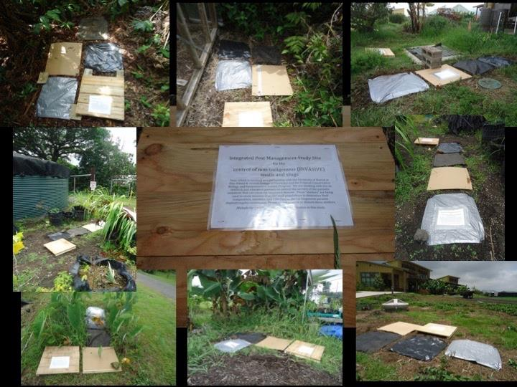
11
Slug and Snail Hunting and Trapping
Slugs and snails are generally active in the evening, nighttime, and early morning to avoid drying, daylight conditions. Collect those that are visible.
During daylight hours these organisms will seek refuge in cool, moist, dark places. You can find them by looking under things like potted plants, boards, etc. Make shelters for them where you can lure and capture them. Slugs and snails will follow each others slime trails, so once they start coming to your shelter, others will follow.
Above: Shelter material trialed at school gardens include wood, cardboard, plastic, tarp, and weed cloth
Shelters can be as small as a overturned pot, a folded tarp, or a piece of cardboard, wood, etc. Many of these pests prefer to shelter on a non-porous surface, such as glazed ceramic. One you start paying attention to them you will start to learn what conditions the slugs and snails prefer. Remember to remove flatworms as well.
Notes:
Slide 12: A very good method for removing slugs and snails without baits is by hunting and using shelters for trapping. Hunts can be carried out during daylight hours by looking under objects where slugs, snails, and flatworms may be hiding during daylight hours. You can also hunt at night when slugs and snails emerge to feed or reproduce. You can also make shelters, which create a cool, moist environment that is attractive for sheltering during daytime hours. Cardboard, plastic (3-6 mil), tarp material, or wood have been shown to be effective materials for shelter construction. As slugs and snails will follow each othersʻ slime trails, shelters will be used by more and more pests over time. Check under shelters and remove unwanted pests.

Slide 12
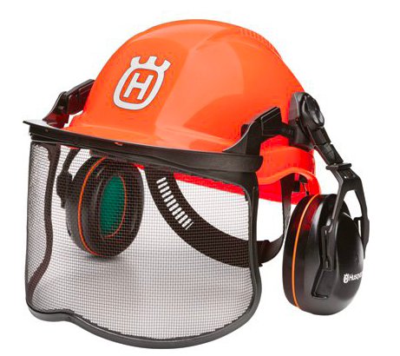
12
Never handle slugs, snails, or flatworms with bare hands.
In addition to rat lungworm infection by oral consumption, mouse studies have shown the rat lungworm can pass through skin that has lacerations, abrasions, and even skin with no abrasions. Additionally, infective larvae can enter through eye, vaginal, or anal conjunctival tissue.
Wear gloves when gardening or when handling slugs or snails. Be careful to prevent contact with slime. If contact does occur, do not scrape the slime off but instead wipe with an alcohol or beach + water solution.
When using power tools, such as a weed-eater, in areas of known rat lungworm presence, protect your face with a face with a full face shield, or googles and a mask. People have reported being sprayed with pieces of slugs or snails that were accidentally chopped when doing this type of work.
Notes:
Slide 13: Infection may be possible through other routes, beside oral consumption. A mouse study by Wang et al. infected mice by intraperitoneal or subcutaneous injections, penetration of eye, vaginal, and anal conjunctival tissue, lacerated skin, unabraded skin, foot pad, and tail penetration. Oral intubation was used as a control. Successful infections were established through all experimental transmission routes except tail skin. Measures should be taken to avoid contact with slugs and snails. These measures can include wearing gloves when working outdoors, especially when working with plants, soil, and debris where slugs or snails might be sheltering. In areas where slugs and snails are present and the rat lungworm is known to be established, wearing face protection when running power tools, especially weed-eaters and lawn mowers, can prevent being hit by pieces of a slug or snail that may be accidentally damaged by equipment. We have heard reports of people having this happen with the giant African snail and Cuban slugs in particular.

Slide 13
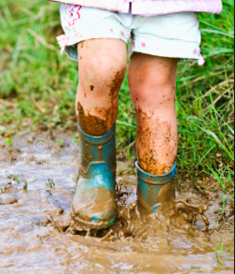
13
Pay attention to small children when playing outdoors in areas where rat lungworm is prevalent.
Do not let children touch or handle slugs or snails or put them into their mouth!
Be cautious of children playing in stagnant water or puddles. It has been shown that infected slugs and snails can shed rat lungworm larvae, especially if smashed, drowned, or dying. Besides rat lungworm disease, other pathogens, such as leptospirosis, can be transmitted in water.
In tropical areas, such as Hawaii, it is a good preventative to wear shoes especially if cuts or abrasions are present.
Notes:
Slide 14: Because of the potential for infection through routes other than oral consumption, and because studies show the rat lungworm parasite can live outside of a dead host for some time in a wet environment, is best to take precautions in areas where there is known rat lungworm infection. Wear shoes when walking outdoors, especially if conditions are wet or if you have cuts or abrasions on your feet. Wear protection especially if you have cuts or abrasions. Keep an eye on small children, Do not let them handle or put slugs or snails in their mouths.

Slide 14
Keeping slugs and snails out of your home
Keeping slugs and snails out of your home
Slugs, snails, or flatworms can be brought into your house unnoticed. Precautions to take to prevent this include:
If bringing potted plants inside for houseplants, the dirt and pot should be thoroughly checked for slug/snails or eggs. Slugs, snails and flatworms will hide in potted plants. Use caution
Check pet food if bringing inside at night
Check fruits and vegetables, such as pineapple tops, bunched greens, any type of fruit, flower, or vegetable that might provide refuge of slugs or snails.
If you have known populations of semi-slugs use extra precaution, as many residents have reported finding these slugs inside the home.
At home, surfaces where slugs and snails may have crawled can be wiped with a bleach + water solution to sterilize and prevent disease.

Slide 15
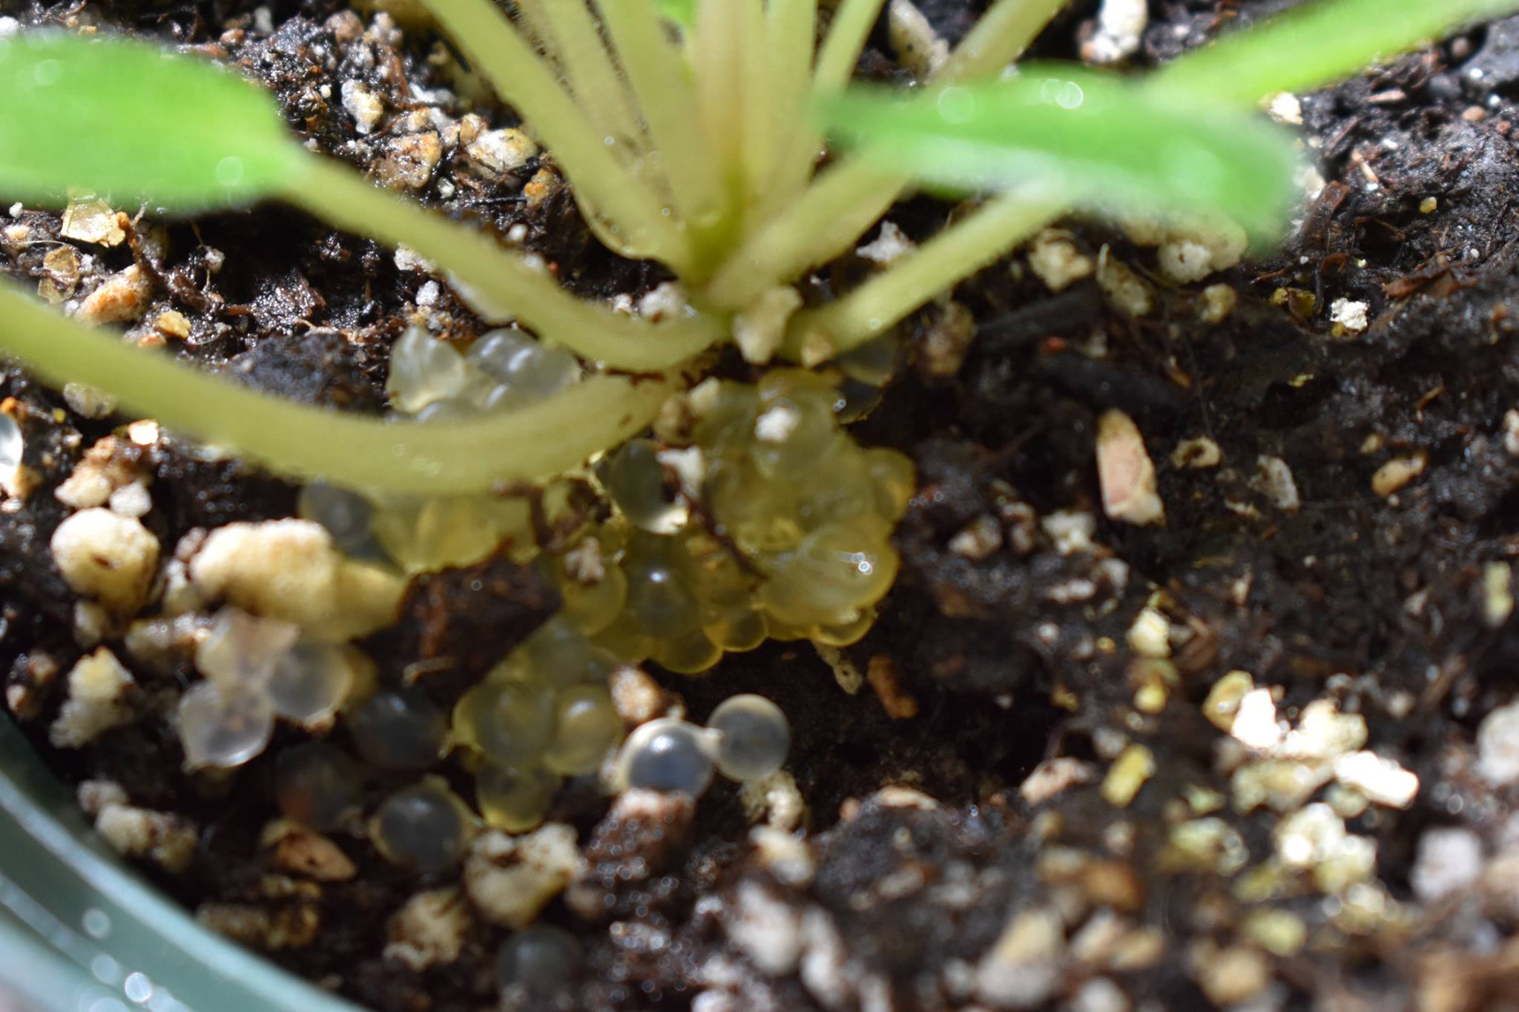
Keeping slugs and snails out of your home
Keeping slugs and snails out of your home
Slugs, snails, or flatworms can be brought into your house unnoticed. Precautions to take to prevent this include:
If bringing potted plants inside for houseplants, the dirt and pot should be thoroughly checked for slug/snails or eggs. Slugs, snails and flatworms will hide in potted plants. Use caution.
Check pet food if bringing inside at night
Check fruits and vegetables, such as pineapple tops, bunched greens, any type of fruit, flower, or vegetable that might provide refuge of slugs or snails.
If you have known populations of semi-slugs use extra precaution, as many residents have reported finding these slugs inside the home.
Photo: Alan McNairie
Slug eggs in a potted plant (above).
Any household/kitchen surfaces where slugs and snails may have crawled can be wiped with a bleach + water solution to sterilize and prevent disease.
Notes:
Slide 15: It is possible to inadvertently bring slugs or snails inside your home, either on plants, or in potted plants. Check fruits that have bunched leaves, such as pineapple tops, or twist off the top and set outside before leaving the fruit inside. We have heard reports of people finding slugs inside of bunched celery and lettuces after they had been placed in a refrigerator for several days. Slugs and snails will hide in soil and some species lay there eggs in soil. Also take precaution when bringing potted plants inside and check for slugs, snails, or eggs of these pests.

Slide 16
Precautions for Angiostrongyliasis Prevention Review
Precautions for Angiostrongyliasis Prevention Review
Inspect and wash all produce. Headed vegetables, such as lettuces, celery, and bok choy need to be taken apart and inspected and washed leaf by leaf. Cooking by boiling or steaming for 3-5 minutes, drying produce in a food dehydrator or air-dried, or freezing for 24-48 hours are good precautions to follow to prevent infection. Watch this food preparation video. Safe Food Preparation: Check, Clean and Cook
Never handle slugs, snails, or flatworms with bare hands.
Put nozzles on hoses to prevent slug entry.
Do not leave pet food unattended at night. Rats and slugs/snails will eat the food. Dogs have been infected in this manner.
Rainwater catchment tanks should be covered and entry by slugs or snails prevented. Maintain filters and UV lightbulb on a regular basis. Potable water should be available at all taps including showers.
Watch small children when outdoors to prevent them from handling slugs or snails, or putting them in their mouth.
Control rats, and slugs, snails and flatworms around homes, gardens, and farms.
Semi-slug in a commercially purchased salad
Notes:
Slide 41. Check, Cook, and Clean all produce. Headed vegetables, such as lettuces, celery, and bok choy need to be taken apart and inspected and washed leaf by leaf. Cooking by boiling or steaming for 3-5 minutes, drying produce in a food dehydrator or air-dried, or freezing for 24-48 hours are good precautions to follow to prevent infection. Watch this food preparation video. https://www.youtube.com/watch?v=PZ2t6CnBFEQ. Don’t handle slugs, snails, or flatworms with bare hands. Always use nozzles on hoses to prevent slug entry. Rats and slugs like to eat pet food left out. Bring in pet food at night. If on rainwater catchment, make sure tanks are covered and proper maintenance is carried out by changing filters regularly, UV bulbs and the catchment tank should be professionally cleaned at least once/year. Potable water should be made available at all taps and showers. Prevent small children from handling slugs or snails, or putting them in their mouth. Rats and slugs can be controlled by either traps or baiting. A Slug Jug can be used to collect slugs and snails. Use wide mouth plastic container, add 7:1 water to salt, punch small hole in the cover, use designated tongs and gloves to place slug/snail in the jug. The slug will drown and the slat will kill the larvae.

