Slide 1

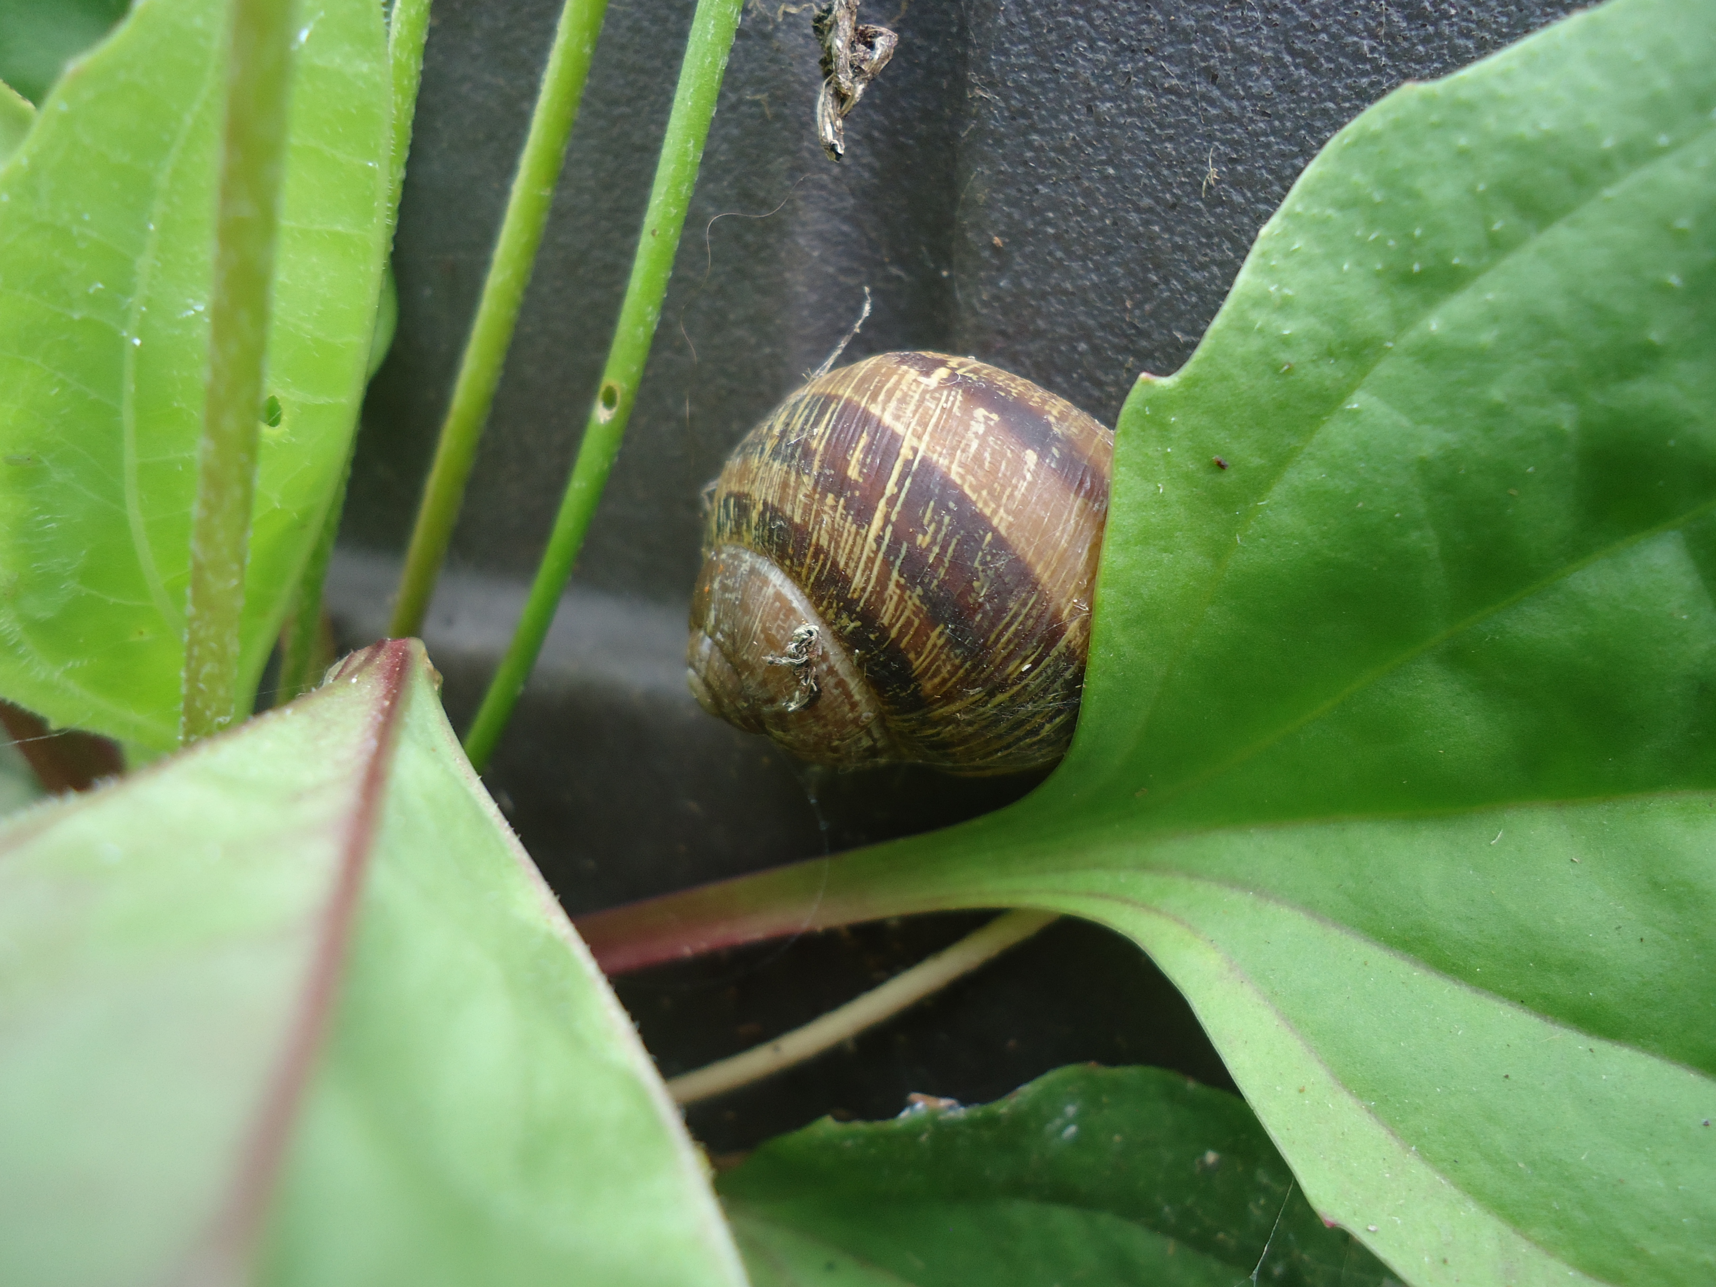
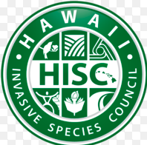
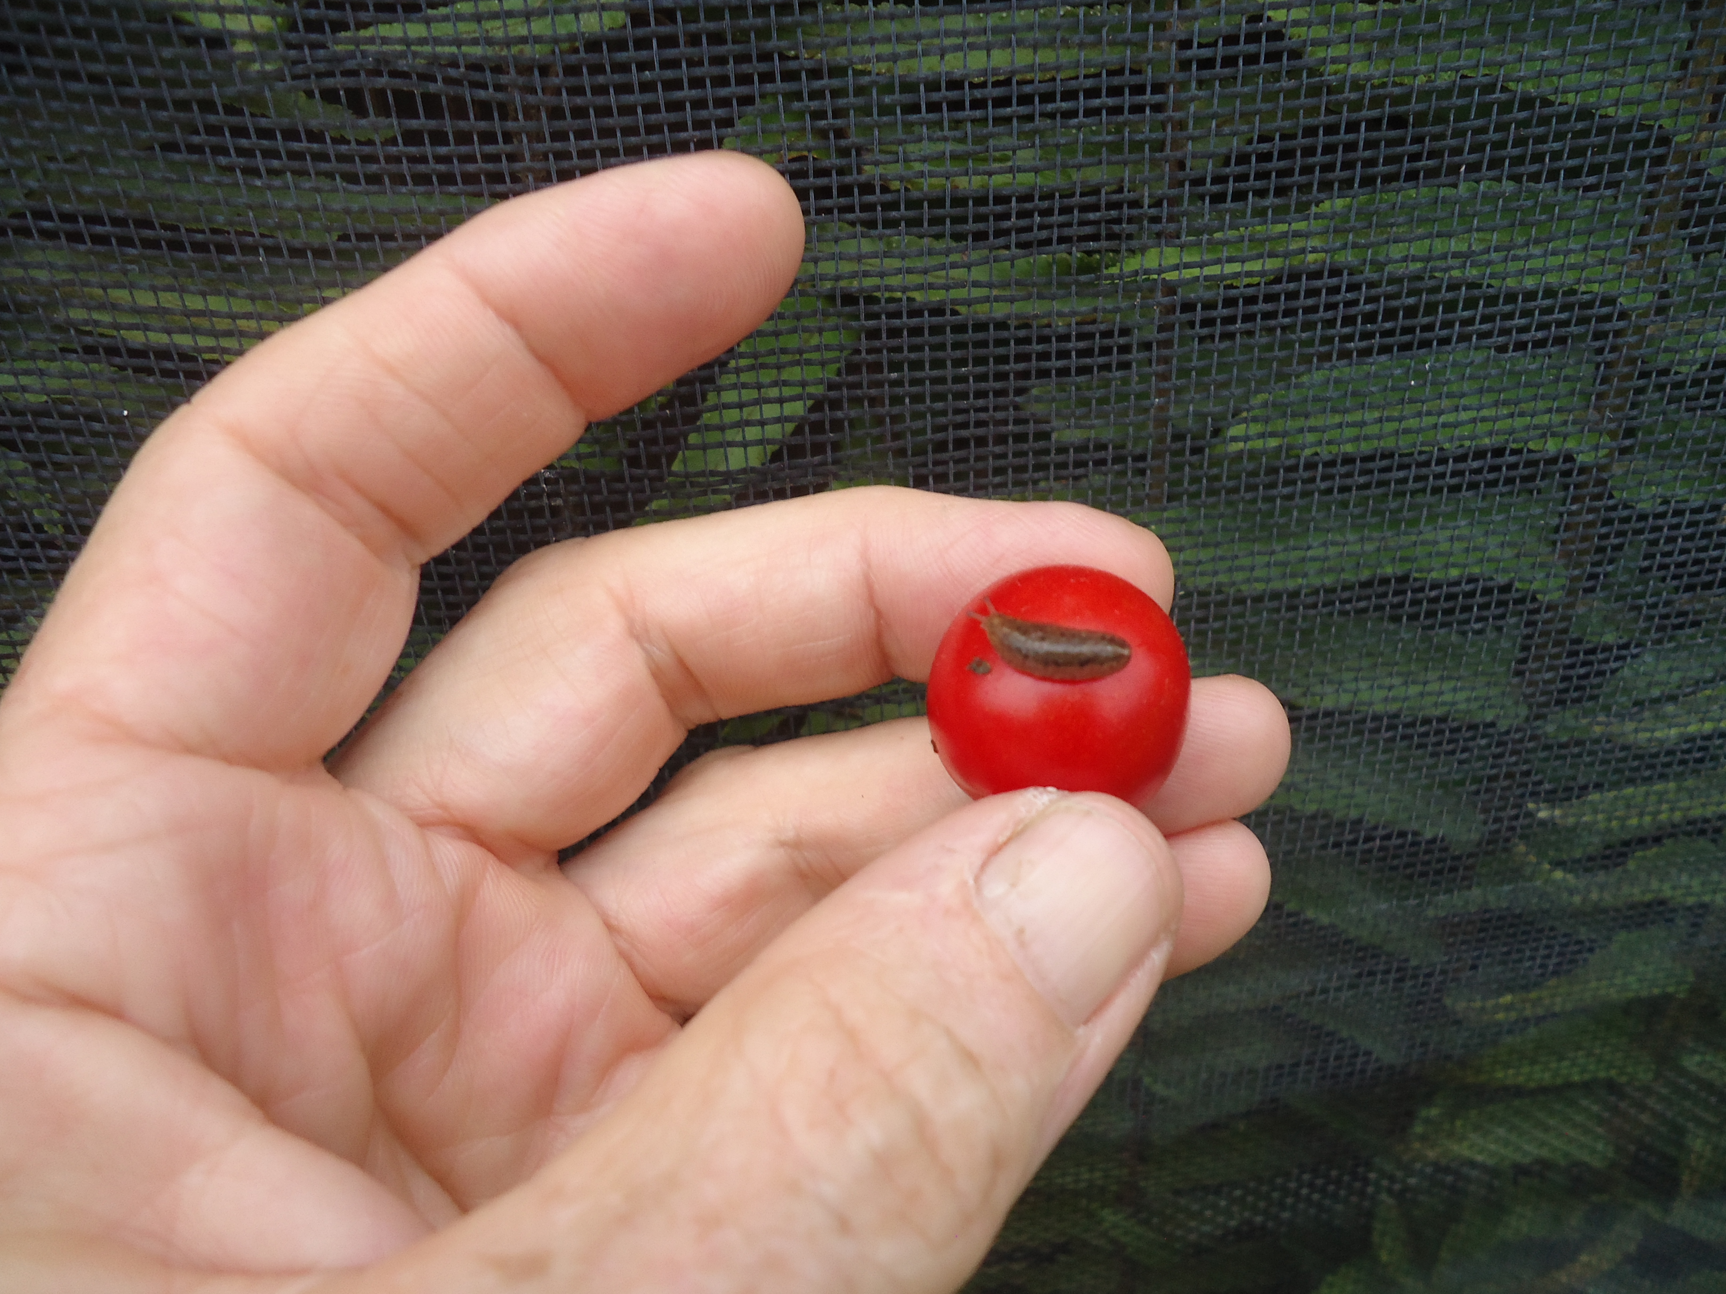

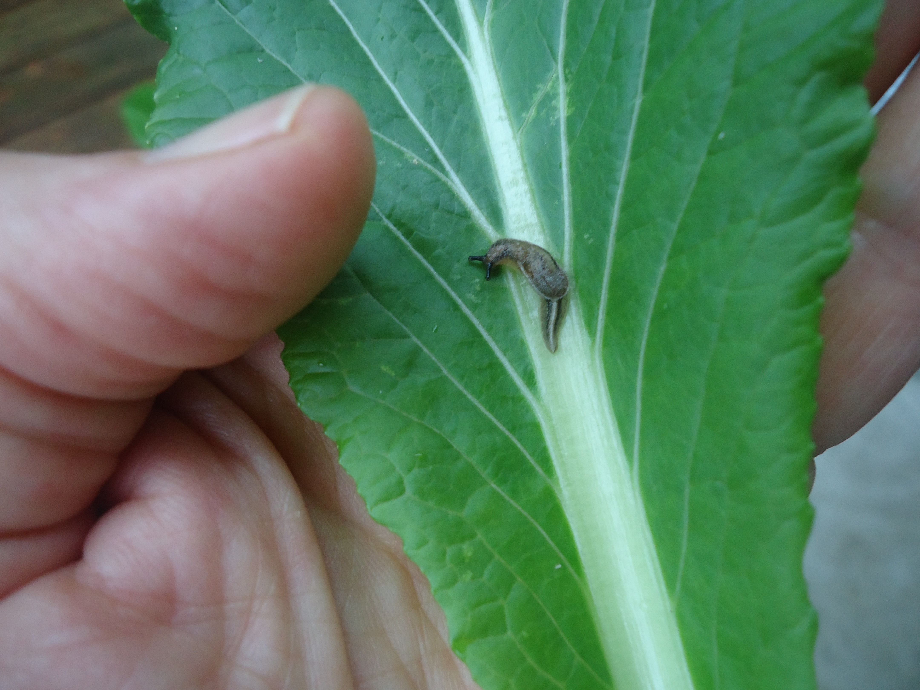

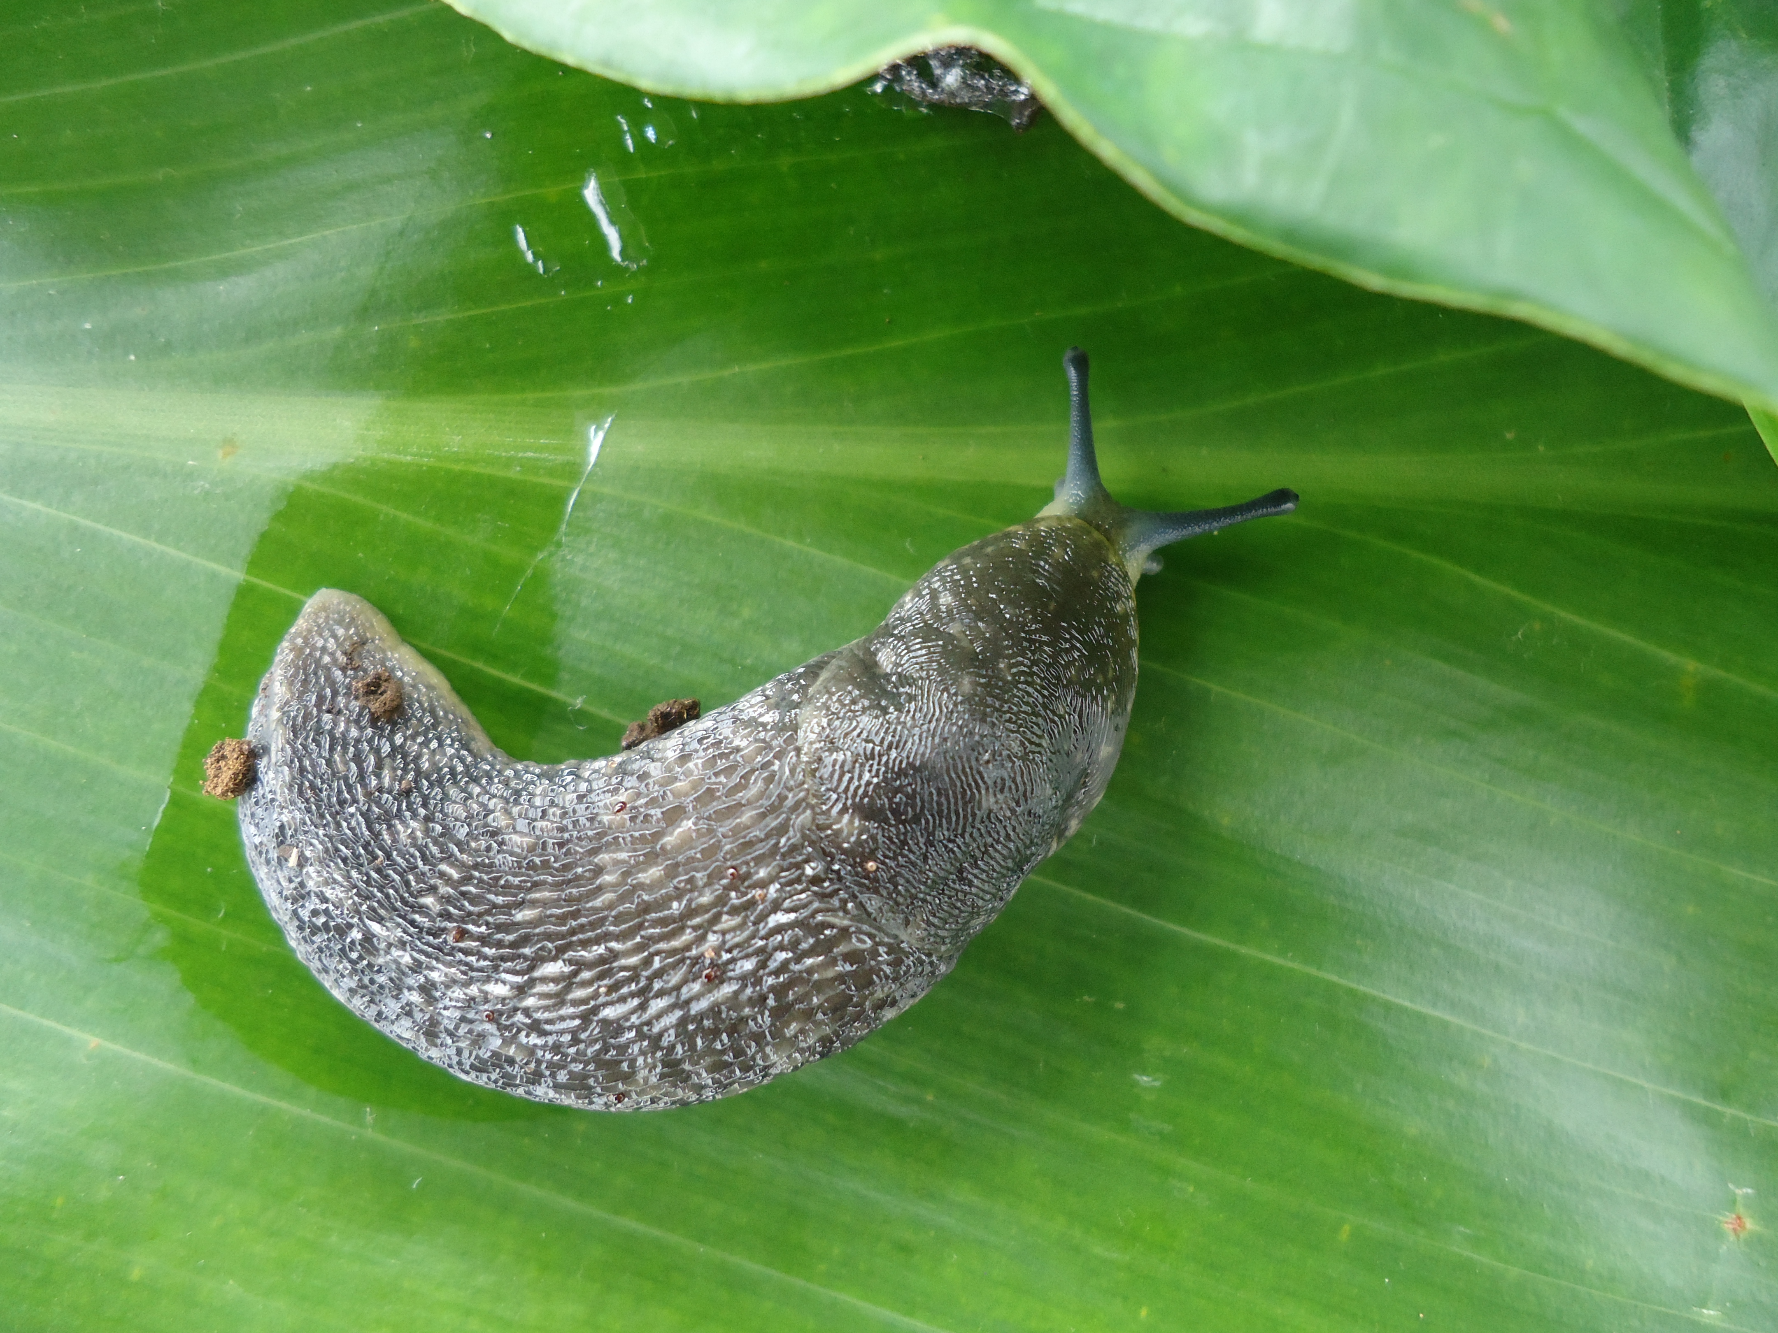



Teacher PDE3 Course
Oct 20/21, 27/28, Nov. 3/4
Fall 2018
With funding from the Hawaii Community Foundation through a
Career Connected Learning Grant

Slide 2
Global Overview
Notes:
Slide 1 Title slide

Slide 3
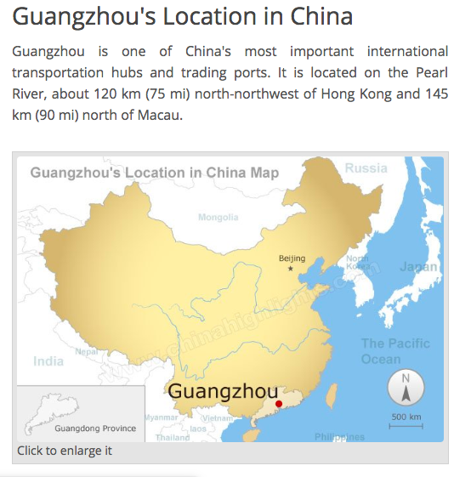
Origin and movement of the rat lungworm parasite
The rat lungworm parasite, Angiostrongylus cantonensis, was first discovered in China in 1935 by a man named Chen, in the city of Canton (now called Guangzhou). The species name, cantonensis, is derived from the name of the city where it was first identified. The parasite was spread across the Pacific Islands during World War II, likely by the spread of rats from Southeast Asia on board ships carrying military equipment.

Slide 4
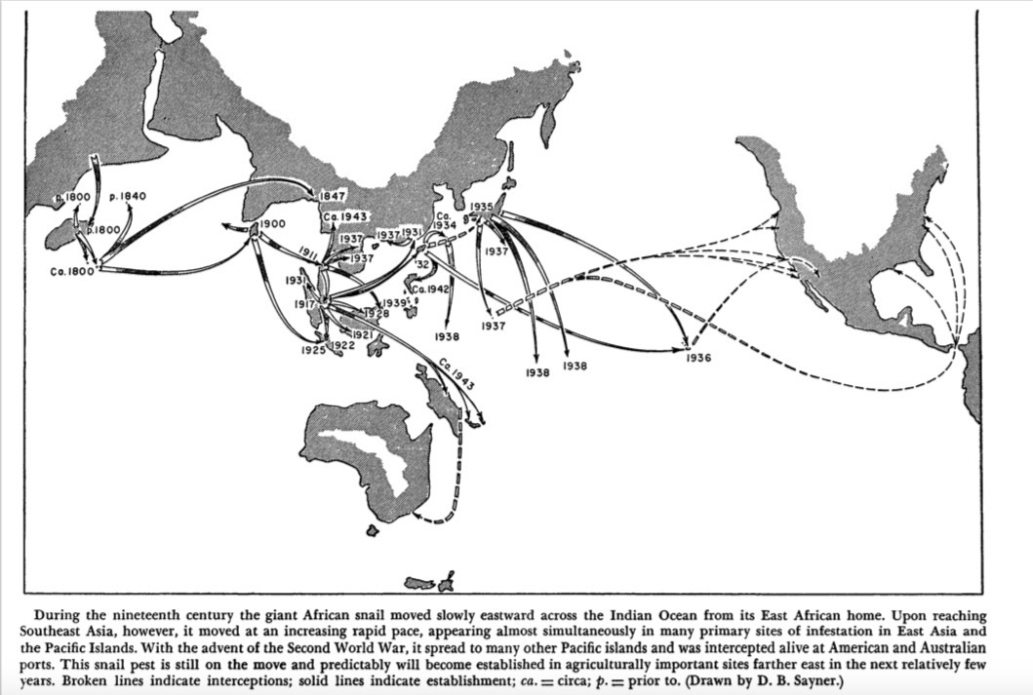
Movement of the giant African snail
Alternatively, the parasite may have been spread, either accidental or intentional by the transport of the giant African snail, Achatina fulica, from its home in Africa.This snail is a known, important carrier of Angiostrongylus cantonensis. This snail first arrived in Hawaii in 1936 in the baggage of a woman returning from Formosa, now called Taiwan. The young woman released them in her garden. That same year a man from Makawao on Maui imported the snail through the mail to sell them for medicinal use. In both cases the snails escaped and became established. This snail is regarded as a serious pest, is established on all of the Hawaiian Islands, and has spread throughout the Pacific Islands.

Slide 5
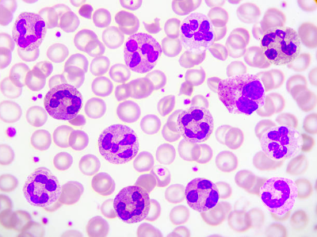
Spread of the parasite through the Pacific Islands
Cases of this disease, which at first was identified as some type of meningitis, began to be seen in some of the Pacific Islands in the 1940ʻs. In Tahiti, hundreds of human cases of this disease were being reported. The disease began to be referred to as eosinophilic meningitis due to the increased cell count of immune system cells called eosinophils.

Slide 6
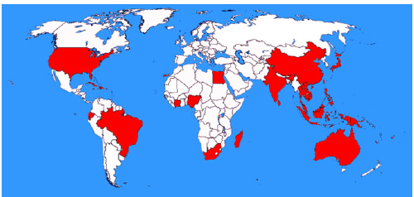
Neuroangiostrongyliasis, or Rat Lungworm Disease (RLWD) caused by Angiostrongylus cantonensis is a GLOBAL disease
Areas which are shaded are countries where A. cantonensis has been detected in naturally infected animals, or where humans have acquired infections. A. cantonensis has been documented as a parasitic disease of humans in Hawaii and other Pacific islands since 1959. The first cases on in Hawaii were on Oahu, and the patients were both Filipino men, one was 50 years old and the other was 70 years old. Both were admitted to the State Mental Hospital due to mental confusion and memory problems. Both victims died, one in 1959 and the other in 1960. Hawaii, particularly the east side of Hawaii Island, is the epicenter for RLWD in the USA.
Image reprinted with permission from: Parasitology. Barratt, J. et al., (2016) Angiostrongylus cantonensis: a review of its distribution, molecular biology and clinical significance as a human pathogen. Parasitology 143, 1087−1118. Copyright © 2016 Parasitology.
Notes:
Slide 2: global map
Origins and history of RLW parasites, how thought to have spread. The nematode Angiostrongylus cantonensis is a rat lungworm, a zoonotic pathogen that is the most common cause of human eosinophilic meningitis and also results in ocular angiostrongyliasis. This nematode was first discovered in China in 1935, and identified as a human pathogen in 1945. It is considered a global, emerging infectious disease commonly known as rat lungworm disease (RLWD) or angiostrongyliasis. Rats are the definitive hosts, and gastropods (slugs and snails) are the intermediate hosts. It is thought that the parasite has been spread primarily by dispersion of infected rats travelling on ships or barges, or to a lesser extent could also be spread by infected gastropods travelling on imported plants. While the parasite has been generally considered as tropical or sub-tropical, cases of angiostronyliasis are becoming more frequent in temperate regions. This could be due to environmental factors such as global warming and the adaptability of the parasite, or the extremely wide intermediate host range of gastropods.
A. cantonensis is now endemic in Asia, Australia, Brazil, the Caribbean islands, and the Pacific Islands, and has spread to the American continent. More than 2,800 cases of human infection have been reported in 30 countries. Nearly 50% of all cases of angiostrongyliasis have been reported in Thailand, largely due to consumption of dishes that contain raw or undercooked snails. Outbreaks in China largely occur on the east coast. Prior to 1996 only three cases were reported but cases have increased in recent years due to the dietary inclusion of giant African snails and apple snails, which are farmed as a food source. Several hundred cases have been reported in Taiwan which were linked to handling or ingestion of raw snails.

Slide 7
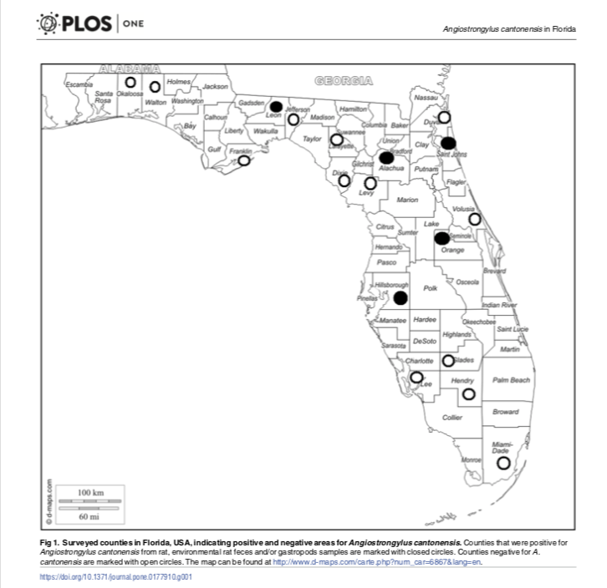
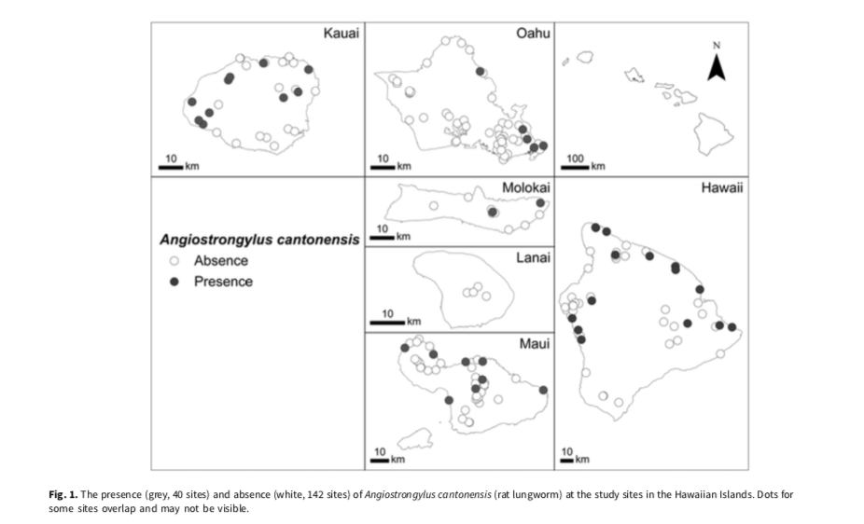
Angiostrongylus cantonensis found in the Hawaiian Islands and Florida
Angiostrongylus cantonensis has been found throughout the Hawaiian Islands (left) with the possible exception of Molokai. In the continental United States it has been found throughout Florida (right) and into the Gulf Coast states to Texas, and up into Tennessee. The parasite range is expected to expand with climate change. The majority of cases have been reported from Hawaii, primarily Hawaii Island, but there have also been cases reported from the U.S. mainland. From January 2011- January 2017 there were 16 cases cases reported from 8 U.S. mainland states including six from California, four from Texas, and one each from Utah, Colorado, Arizona, Alabama, Tennessee, and New York. Six (four in Texas and one each in Tennessee and Alabama) had no known history of travel outside of the continental U.S. The travel history was unknown for two of the California cases.
Left: Kim et al. 2018. Modelling the distribution of Angiostrongylus cantonensis (rat lungworm) in its gastropod hosts. Parasitology. https:// doi.org/10.1017/S0031182018001026
Right: Stockdale Walden et al. 2017. Geographic distribution of Angiostrongylus cantonensis in wild rats (Rattus rattus) and terrestrial snails in Florida, USA. PLOS ONE | https://doi.org/10.1371/journal.pone.0177910
Notes:
Slide 3. Map of A. cantonensis in Hawaii and Florida
In the US, most of the cases have originated in Hawaii, particularly on the east side of Hawaii Island, however the parasite has been found on all of the main Hawaiian Islands, with the possible exception of Lanai (Kim et al., 2018). The earliest cases in Hawaii were reported in 1959 of two men on Oahu, where upon autopsy, A. cantonensis larvae were found in their CNS/brains. Between 1959 and 1965, there were 19 cases reported. There are no available records on cases from 1966–2000 since it was not a reportable health condition during that time. There have been 46 laboratory-confirmed cases and 37 probable cases, resulting in a total of 83 cases statewide reported to the health department since tracking of angiostrongyliasis began in 2007. Two adult deaths related to the disease have been reported, one in 2012 and another in 2015 (Rat Lungworm Disease in Hawaii. Control and Prevention Legislative Report. Hawaii State Dept. of Health, March 2018).
On the U.S. mainland the parasite if found in the Gulf Coast states from Florida to Texas. A recent study (Stockdale Walden et al., 2017) found the parasite throughout the state of Florida. From January 2011- January 2017 there were 16 cases cases reported from 8 U.S. mainland states including six from California, four from Texas, and one each from Utah, Colorado, Arizona, Alabama, Tennessee, and New York. Six (four in Texas and one each in Tennessee and Alabama) had no known history of travel outside of the continental U.S. The travel history was unknown for two of the California cases (Liu et al., 2018).

Slide 8
Cases of neuroangiostrongyliasis in humans have increased significantly in recent years. The estimated numbers of cases are provided by physicians to the Hawai`i Department of Health (HDOH) and Hawai`i Health Information Corporation (HHIC). The HHIC obtains its data from hospital discharge records.
Notes:
Slide 4. Numbers of cases in Hawaii
While A. cantonensis has been endemic in Hawaii since the 1950’s, the number of angiostrongyliasis cases has increased since the turn of the millennium. This increase parallels the introduction of the semi-slug (Parmarion martensii) to east Hawaii Island circa 2004. This gastropod is now spreading across the entire island. A total of 24 angiostrongyliasis cases were reported in Hawaii from 2001-2005 (Hotchburg et al., 2007), but while these cases did occur, angiostrongyliasis cases were not reported by the Hawaii Department of Health (HDOH) until 2007, at which point it became a reportable disease. An average of 5.3 cases were reported by the HDOH between 2007-2009 (no data is provided for 2006). For the period 2010-2014 the HDOH reported an average of 5.2 cases. During the same time period an average of 2.4 human cases were reported by the non-profit Hawaii Health Information Corporation (HHIC), which bases their numbers on discharge data from hospitals and emergency rooms statewide. In 2015 the DOH reported seven cases and the HHIC reported nine cases. In 2016 the DOH reported 11 cases statewide while the HHIC reported 21 cases. From January to April 2017, HHIC reported 16 cases of angiostrongyliasis in Hawai‘i including an outbreak on Maui. The invasive semi-slug has only recently been documented on Maui (for the first time) and an outbreak of five angiostrongyliasis cases were reported in the first two quarters in 2017 from Maui. From 2007-2016 the DOH reported 3 cases originating from Maui. The DOH did not report any non-resident cases (visitors) from 2007-2014, but report 1 each in 2015 and 2016. It is generally acknowledged that the number of angiostrongyliasis cases continues to be underreported in the State of Hawaii. Contributing factors likely include the difficulty of diagnosis, inadequate healthcare provider education and awareness, and lack of a comprehensive reporting system. These issues need to be resolved for the State of Hawaii to provide accurate data on the true number of angiostrongyliasis cases in both residents and non-residents that have originated in Hawaii.

Slide 9
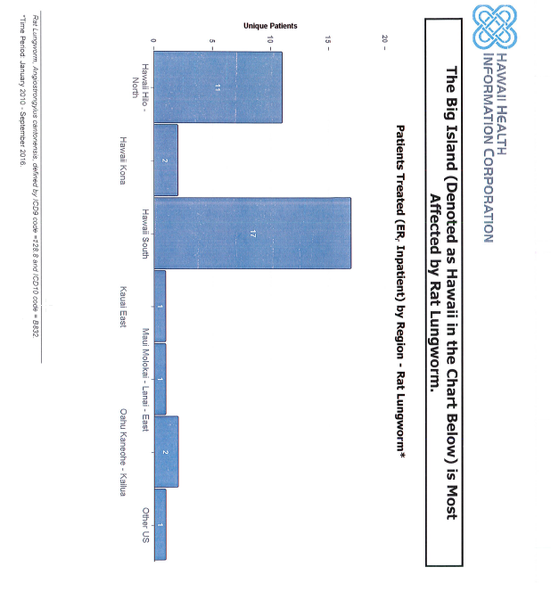
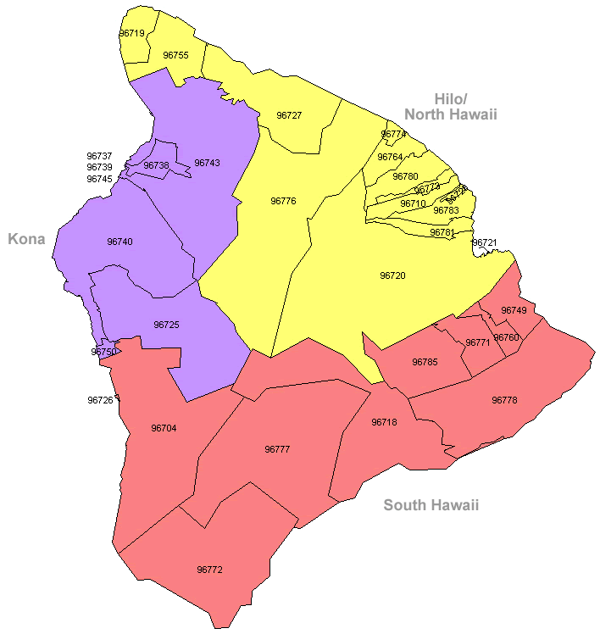
Why do most neuroangiostrongyliasis cases originate on Hawaii Island?
Notes:
Slide 5. What the numbers tell us is that most of the human cases originate on the east side of Hawaii Island. Why this is, isn’t entirely clear. But there are clues. One reason is likely related to the introduction of the semi-slug to east Hawaii in 2004. Since then, we have seen the spread of the semi-slug, essentially all around the island, and with it, an increase in the number of human cases. Secondly, A. cantonensis larvae can live for long periods of time in water. East Hawaii Island has widespread use of unregulated rainwater catchment as a source of household and agricultural water. It is likely that transmission of this parasite by water may be a reason for the high number of cases originating in this region.

Slide 10
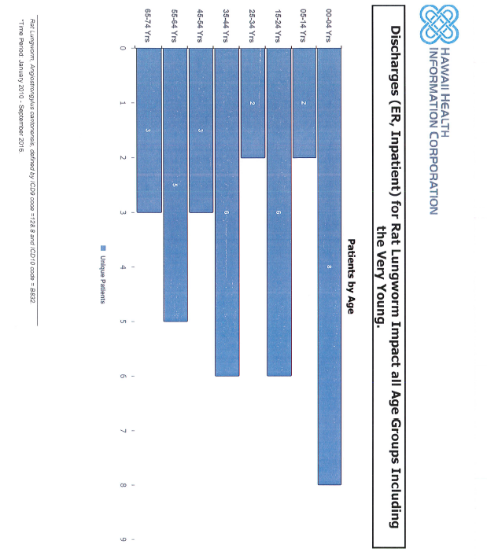
Neuroangiostronyliasis affects all ages with greater numbers of cases documented in children under 4 years of age in Hawaii.
Notes:
Slide 6. While A. cantonensis doesn’t discriminate against age, young children seem to become infected more frequently than older persons. This could be related to the fact that young children like to put objects in their mouths. This same phenomena occurs in puppies, which get infected far more frequently than older dogs.

